Slide 1
About This Presentation
READ THE SLIDE NOTES FOR PRESENTATION DETAIL
Author(s) | VCF Technical Marketing | VMware by Broadcom
How to use this deck | This VCF What’s New Technical presentation discusses new features and capabilities of a VMware Cloud Foundation release. For a more comprehensive technical overview please use the VCF Technical Overview presentation. This deck may be updated frequently - ensure you are using the most recent revision.
Distribution and Audience type | This presentation is primarily intended for existing VCF customers who want to learn about the features and benefits in the latest GA version of VCF. These slides in PowerPoint format are not to be redistributed outside of Broadcom. Convert the slides to PDF before sharing externally. The speaker notes are the property of Broadcom and may not be distributed in any manner. Read the speaker notes carefully before presenting this material. All content in speaker notes is provided for educational purposes only and is not intended to be disseminated widely to non-Broadcom employees. Check the documentation for the final “how to” for any feature.
Content Type | Intermediate 200 Level. Suitable for Infrastructure Architects, Cloud Architects, Virtualization, Storage and Networking teams
Time To Present | Minimum of 120 minutes allowing time for discussion and interaction.
Last updated | First Published June 2025
Primary Copy (PDF)
CONTENT UPDATED REGULARLY: Please download the latest copy from the SRC prior to presenting
Notes:
Key Message:
Understand how to best use this deck.
Talk Track:
This VCF What’s New Technical presentation discusses new features and capabilities of a VMware Cloud Foundation release. It can be delivered within a 120 minute timeframe which allows time for discussion and interaction.
This deck is broken up into several sections, each focused on a particular subject.
This allows you to present the material that is specific to your audience and avoid topics that may not be relevant or of interest.
Please refer to the agenda for the complete list of topics. Each slide in this deck will contain a set of speaker notes to help guide you in presenting the material.
The talk track is a guide that you can personalize to match your own presentation style.
For a full VCF technical overview with a lot more technical detail please refer to the VCF Technical Overview presentation.
This content is not a replacement for product documentation.
Refer to individual product resources and documentation for product specific technical details.
Notes:
From time-to-time content contained within this deck is modified and updated so…
PLEASE ENSURE YOU DOWNLOAD THE LATEST COPY FROM THE SRC PRIOR TO PRESENTING THIS CONTENT.
For vendor integrated solutions of VMware Cloud Foundation some of this content may not apply. Please refer to your vendor.
Resources:
For further technical information please refer to the Cloud Foundation Documentation
https://docs.vmware.com/en/VMware-Cloud-Foundation/index.html

Slide 2

VMware Cloud Foundation 9.0
What’s New Technical – Part 1
Presenter:
June, 2024
Notes:
Key Message:
Opening slide
Talk Track:
Welcome! My name is <name> and I work in the <name or organization> at Broadcom. Today, I want to talk to you about the new features and functionality that have been added into VMware Cloud Foundation 9.
Notes:
Resources:
To gain a greater understanding of VCF features, key concepts and how they are used please refer to the VCF Technical Overview presentation.
VMware Cloud Foundation 9.0 Release Notes:
https://docs.vmware.com/en/VMware-Cloud-Foundation/index.html

Slide 3


Agenda
Modernize Infrastructure
Deliver a Unified Cloud Experience for Developers
Secure and Protect Your Private Cloud
Appendix Licensing | Add-on Services | Resources
Notes:
Key Message:
Agenda slide
Talk Track:
Here is our agenda.
Notes:
Resources:
To gain a greater understanding of VCF features, key concepts and how they are used please refer to the VCF Technical Overview presentation.
VMware Cloud Foundation 9.0 Release Notes:
https://docs.vmware.com/en/VMware-Cloud-Foundation/index.html

Slide 4


What’s New in VMware Cloud Foundation 9
Deliver a Unified
Cloud
Experience for Developers
Secure
and Protect your Private Cloud
Modernize
Infrastructure
VCF Deployment Pathways
SDDC Infrastructure
Fleet Management & Operations
Deliver Self-service IaaS
Migrating to VCF
Infrastructure for Kubernetes
Private AI
Security Operations
Extended VM-level Data Protection
Protecting VMs Across Clusters
Resiliency & Security
Notes:
Presenter Note: This slide contains animation
Key Message:
VMware Cloud Foundation Drives Modernization, Enhances Developer Productivity and delivers a highly Secure cloud platform.
Talk Track:
VMware Cloud Foundation Drives Modernization, Enhances Developer Productivity and delivers a highly Secure cloud platform.
As we dive into VCF, we will see how VCF 9 streamlines infrastructure management and reduces complexity through deployment, streamlines day 2 operations and streamlines the implementation of self-service IaaS within your data center. We will also explore how VCF 9 accelerates development cycles through infrastructure that is easy to consume and update for Kubernetes and Private AI. How as a platform it delivers a security and resiliency which you can continuously count on. And how it delivers faster time to value, by bringing together key stakeholders using a modern private cloud.
<click> Let’s start first with Modernize infrastructure.
Notes:
Resources:

Slide 5

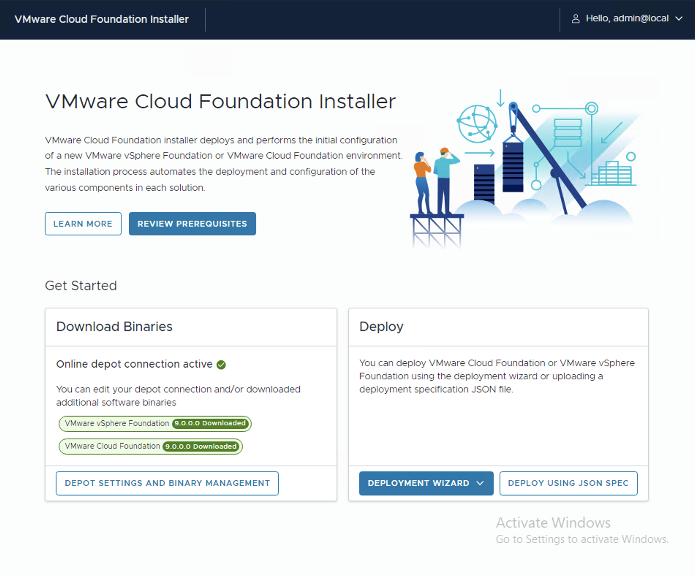
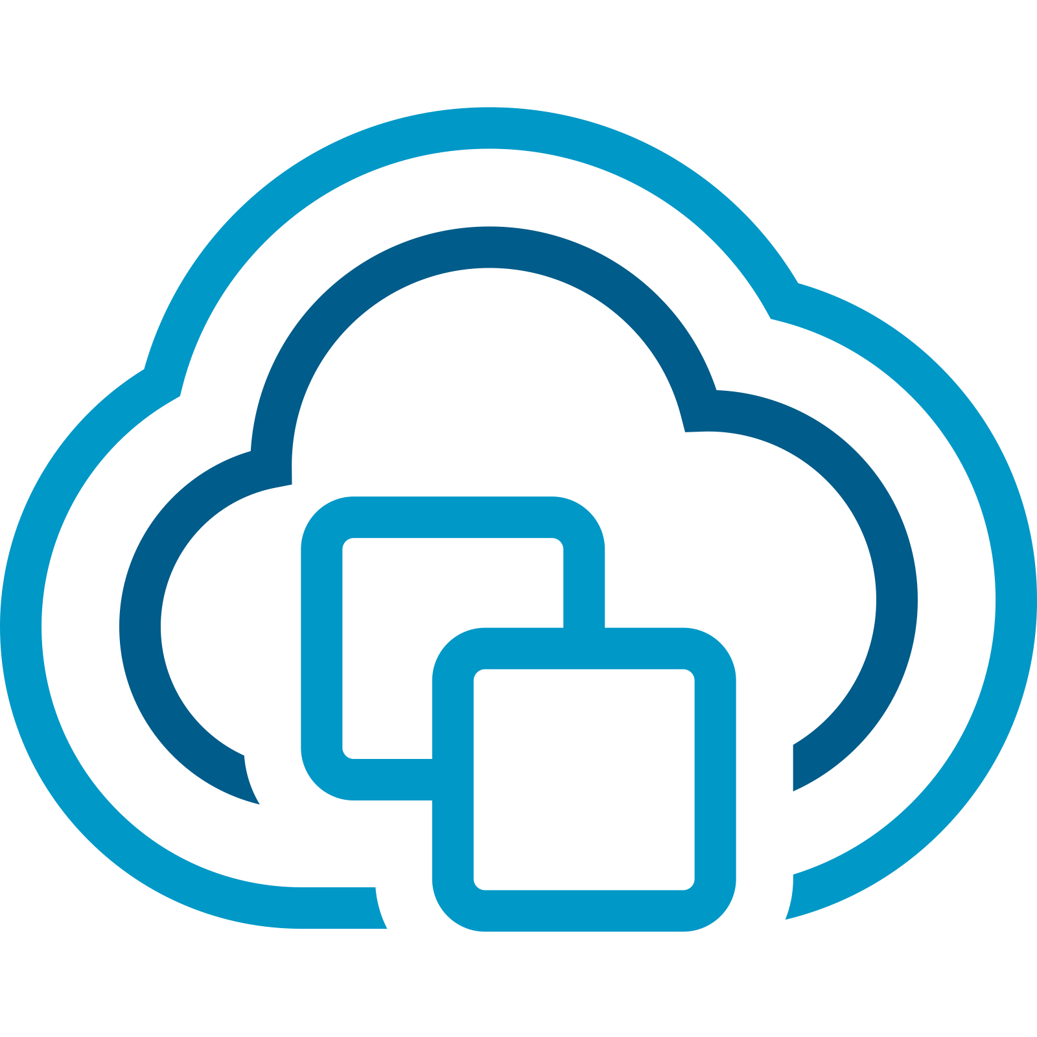
Deployment Pathways to Suit a Variety of Use Cases
VMware Cloud Foundation deployment workflows from the VCF Installer
VCF Installer Appliance:
Deploy a new VCF Fleet or Expand an existing VCF Fleet
vSphere with / without vSAN
VCF Networking (NSX)
VCF Operations
VCF Automation
Converge an existing vCenter deployment to VCF
vSphere with / without vSAN
VCF Operations
VCF Automation
V\
VCF 9.0
VMware Cloud Foundation
VCF Automation
VMware vSphere
VCF Operations
Cluster 1
Cluster 1
Cluster 2
Cluster 2
Cluster …N
Cluster …N
VCF Installer
Existing Deployment
vCenter Server
NSX Manager
Core Infrastructure
New / Expanded VCF Fleet
Notes:
Presenter Note: This slide contains animation
Key Message:
VCF 9 can be implemented into a new or existing environment in a number of different ways using user-driven UI workflows. The VCF Installer appliance provides an easier, quicker and more repeatable set of workflows for our customers to get on the pathway to VCF
Talk Track: VMware Cloud Foundation 9 is a major release which includes a number of significant new capabilities and a more integrated experience for private cloud administrators.
The VMware Cloud Foundation Installer appliance (VCF Installer) is new to VCF 9 and introduces a more flexible set of workflows for deploying VMware Cloud Foundation to suit an extended set of use cases and topology types.
<click 1>
The VCF Installer can be used to deploy a new VCF Fleet …or for customers with multiple environments they can choose to deploy another VCF instance into an existing VCF Fleet. Each VCF instance is deployed using vSphere and vCenter server, NSX, VCF Operations and VCF Automation. Configuring your VCF environment for vSAN delivers a full SDDC stack.
<click 2>
The VCF Installer appliance also contains inbuilt workflows to converge (re-use) an existing vCenter deployment (a non-VCF deployment) to a VCF management cluster.
When performing a conversion, the VCF Installer is to be deployed into the same cluster as the residing vCenter Server appliance. We support existing vCenter clusters configured for vSAN or existing clusters configured with external storage.
Once converged, the environment then becomes a fully functioning new VCF instance which is then managed, scaled and lifecycle managed as VCF. This isn’t all the VCF Installer can do. The VCF Installer workflow also provides options to converge an existing VCF Operations instance and/or an existing VCF Automation instance.
The VCF Installer appliance provides an easier, quicker and more repeatable set of workflows for our customers to get on the pathway to VCF
Notes:
- Existing vCenter deployments which can be reused (converged) and imported includes vCenter Server clusters configured as VMware vSphere Foundation (VVF).
Re-using/converging an existing vCenter deployment to VCF: - The VCF appliance workflows to re-use an existing vCenter deployment will converge the first cluster within the vCenter to a VCF management cluster. All clusters within the vCenter Server are converged into the VCF management domain. - vSphere clusters configured with/without vSAN can be used when re-using (converging) a vSphere cluster to a VCF management cluster using the VCF Installer. NSX is deployed as part of the conversion process.
Resources:

Slide 6








Unified Installer Streamlines Deployment
VMware Cloud Foundation Installer Appliance
VCF Installer Appliance:
Streamlines deployment of VCF or VVF from a single appliance
Inbuilt options to re-use existing vCenter, VCF Operations and VCF Automation instances
Full stack deployment and lifecycle management of compute, storage, networking, operations and automation
Generate a re-usable JSON spec which can be uploaded, reviewed and validated from the UI
VCF 5.x
VCF 9.0
Aria Operations
Aria Ops Logs
Aria Automation
Aria Ops Networks
Aria LCM
VIDM
VMware Cloud Foundation
VMware Cloud Foundation
VCF Automation
VCF Operations
SDDC Manager
vCenter Server
NSX Manager
vCenter Server
NSX Manager
Core Infrastructure
CB
XLS
The VCF Installer automates deployment of a ready-to-use Private Cloud
Cloud Builder
XLSX /JSON
VCF Import
Notes:
Presenter Note: This slide contains animation
Key Message:
Cloud Foundation introduces a more flexible process to deploy a standardized workload-ready private cloud in a matter of hours.
Talk Track: Let’s take a closer look at the VCF Installer appliance.
The VCF Installer appliance replaces the Cloud Builder appliance and further streamlines the deployment of VMware Cloud Foundation (VCF) or VMware vSphere Foundation (VVF).
It contains an inbuilt UI-driven workflow and no longer requires the use of the Deployment Parameters Workbook (MS Excel spreadsheet). The VCF Installer also includes in-built options to converge and import existing vCenter, VCF Operations and VCF Automation instances without the need for VCF Import scripts.
Prior releases of Cloud Foundation have required Aria Operations and Aria Automation to be installed and lifecycle managed as separate Day 2 operations. From VCF 9, the VCF Installer appliance is used to deploy the full VCF stack comprising of compute, storage, networking, operations and self-service automation and VCF Operations is used to lifecycle manage the full stack.
Administrators can choose to initially deploy VCF using the in-built workflows. The VCF Installer can also generate a JSON which can be re-used after uploading, reviewing and validating from the wizard driven UI.
The VCF Installer appliance provides a flexible set of options which help to further simplify the deployment of an end-to-end private cloud environment.
Notes:
The Planning and Preparation Workbook can be useful when planning a VCF 9 deployment and provides detail on the inputs required for the VCF Installer wizard driven workflow. Resources:
Planning and Preparation Workbook: <techdocs link>

Slide 7
Flexible Deployment Workflows
VMware Cloud Foundation Installer Appliance
Choice of Depot:
Online or Offline depot
Choice of Deployment Method:
Wizard-driven or re-usable JSON
Choice of VCF Topology:
Deploy to a new or existing VCF Fleet
Deploy New or Existing Components:
vCenter, NSX¹, VCF Ops, VCF Automation
Choice of Appliance Model:
Simple (single node) or HA (multi-node)
¹ Existing vCenters with NSX installed are not initially supported to be converged to VCF Existing vCenters with NSX installed can be imported into VCF as Workload Domains
Notes:
Key Message:
The VCF Installer appliance can be used to deploy VMware Cloud Foundation or VMware vSphere Foundation to suit a variety of customer use cases and deployment topologies.
Talk Track:
Inbuilt into this new and very light-weight VCF Installer Appliance are a set of enhanced deployment workflows and many new configuration options.
Upon connecting to the Broadcom Support Portal, the user downloads the software binaries by connecting to the online depot. The software binaries are not included in the VCF Installer appliance.
Customers also have the option to configure their own private off-line depot which can be used by multiple VCF instances. With an offline depot, the software binaries only need to be downloaded once which is very handy when managing multiple VCF instances.
Once the software binaries have been downloaded, the appliance can be used to deploy VMware Cloud Foundation (VCF) or VMware vSphere Foundation (VVF). Deployment can be driven using the inbuild Deployment wizard or the user can generate a re-usable JSON spec which can be uploaded, reviewed and validated from the UI. A JSON spec can also be uploaded and edited in the wizard.
A VCF instance can be deployed as part of a new VCF Fleet or to an existing VCF Fleet. A VCF Fleet may consist of multiple VCF deployments which can leverage common VCF Operations and VCF Automations instances.
The VCF Installer is used to initially configure the management cluster which can be deployed in one of two ways: - New components can be deployed which include VM appliances for vCenter Server, NSX, VCF Operations and VCF Automation.
- OR…. existing appliances for vCenter Server, VCF Operations and VCF Automation can be used.
When choosing to converge (re-use) an existing vCenter Server the VCF Installer will converge an existing vSphere / vSphere with vSAN cluster to a VCF management cluster. The VCF Installer will deploy NSX as part of the conversion process.
If choosing to re-use an existing VCF Operations instance, it ,is recommended to select the vCenter server where it is deployed as the vCenter for first VCF management cluster.
The VM appliances for a new VCF Operations, VCF Automation and NSX instances can be deployed using one of two models:
A simple model will deploy a single node appliance for each component that needs to be installed.
When deployed using the High Availability model 3x NSX Manager nodes, 3x VCF Operations nodes and 3x VCF Automation nodes are deployed. Additional options are available to configure an NSX load balancer appliances for selected components.
Extended Talk Track:
Storage and compute for the management cluster can then be allocated. The number of hosts required is dependent upon the storage type selected.
NSX is deployed and ready to be configured and consumed for software defined networking. Enhanced Datapath is the default selection; switching configuration is more granular with advanced options for DVPG load balancing and uplink settings.
Prior to commencing the build, the workflow allows the user to review the deployment parameters and performs a validation to test the inputs. The VCF Installer will then provide recommendations on any changes which may be required before the fully automated private cloud deployment commences. Upon a successful deployment, the VCF Installer provides a link to launch VCF Operations which is used for management.
Notes:
An offline depot is configured at a customer site and is beneficial for VCF deployments which are not internet connected. An offline depot can also be used to service multiple VCF instances.
The Planning and Preparation Workbook can be useful when planning a VCF 9 deployment and provides detail on the inputs required for the VCF Installer wizard driven workflow.
From VCF 9 VCF Operations is used to manage one or more VCF instances. SDDC Manager 9 is installed or upgraded as a component of any VCF 9 instance. SDDC Manager will be deprecated in a future release.
From VCF 9 the management cluster can be configured using vSAN ready nodes (recommended). Qualified vSphere server hardware can be used to support NFS/VMFS on FC) storage topologies. Consult the VMware Compatibility Guide for further detail.
A new (greenfield) VCF deployment requires a minimum of 4 hosts for the management cluster which is deployed using vSAN, NFS or VMFS on FC.
A minimum number of hosts are required when re-using/converging an existing vCenter environment to VCF. (3 vSAN ready nodes or 2 vSphere hosts configured using NFS or VMFS on FC). Refer to the VCF configmax site for further detail.
A minimum number of hosts are required when importing existing vCenter environments into VCF as a workload domain. (3 vSAN ready nodes or 2 vSphere hosts configured using NFS or VMFS on FC). Refer to the VCF configmax site for further detail.
The management domain of a new (greenfield) VCF instance is configured for NSX. Each workload domain is also configured for NSX and is ready to be configured for NSX Virtual Networking (SDN).
¹ VMware supports converging (re-using) existing vSphere clusters to VCF. Existing vCenter environments to be converged can be pre-deployed with vSphere or vSphere with vSAN. Existing vCenter environments with NSX installed are not initially supported to be converged to a VCF management domain at this time. A fresh instance of NSX is installed as part of the process.
Existing vCenter environments with NSX installed can be imported as Workload Domains.
A new VCF instance is deployed in evaluation mode. VCF is fully functional while the deployment is running in evaluation mode and allows a user to deploy additional hosts, workload domains and clusters. The VCF 9 instance is required to be licensed within the first 60 days of a deployment using a license file. VCF Operations directs the user to the Broadcom Business Services Console to complete this process.
Resources:
Planning and Preparation Workbook: <techdocs link>
VMware Configmax site: https://configmax.esp.vmware.com/home

Slide 8
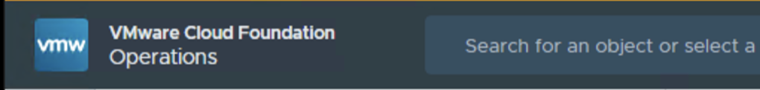

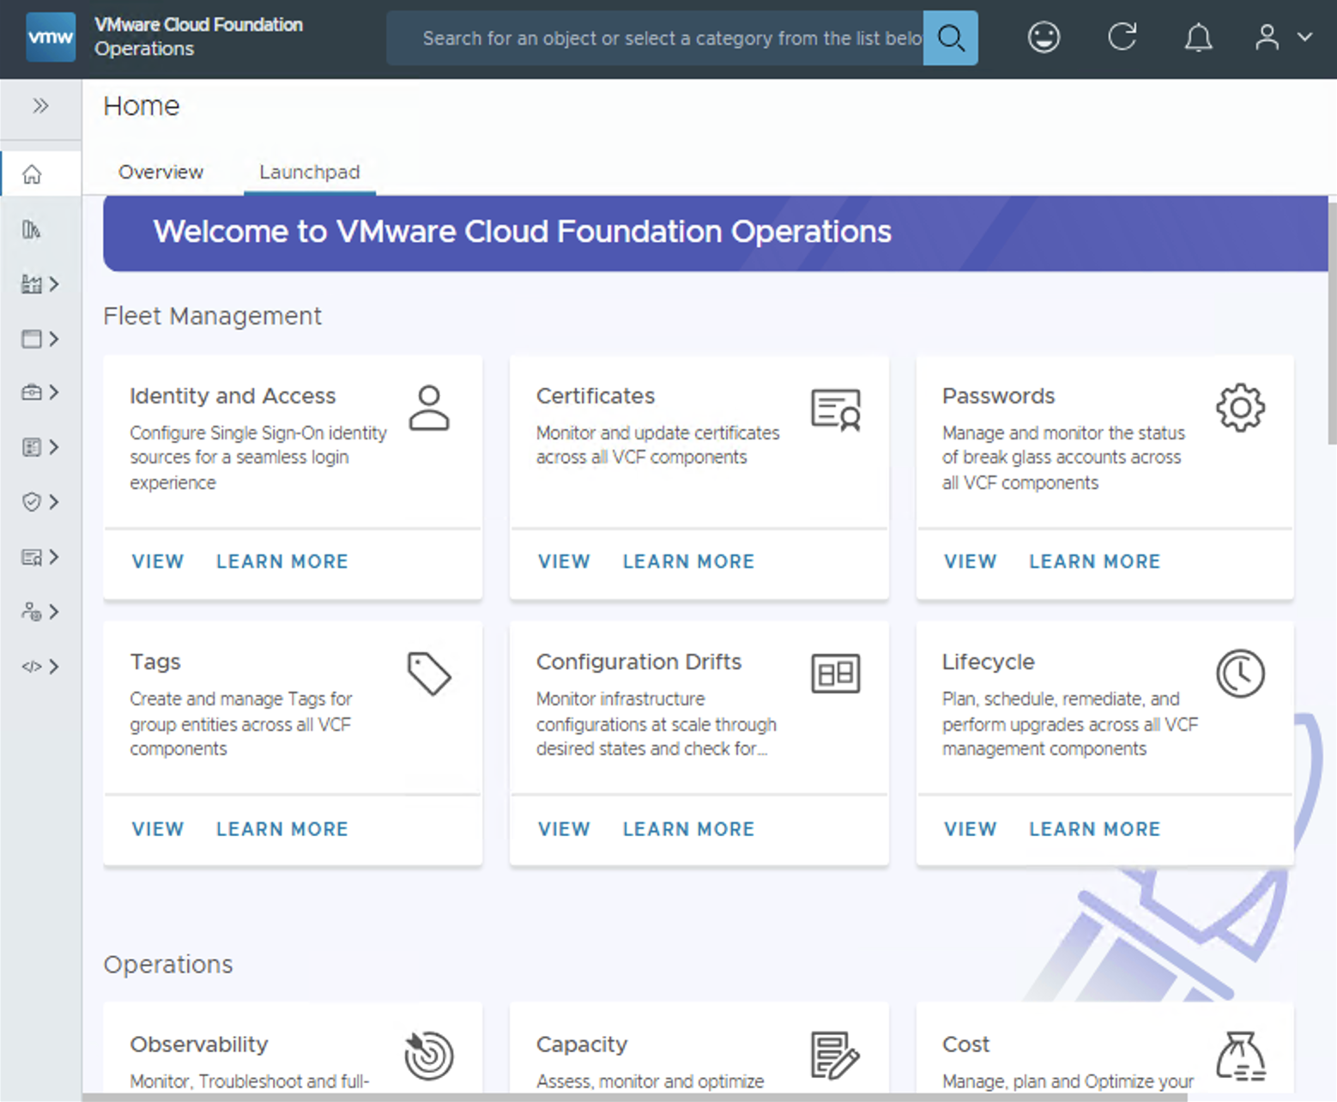

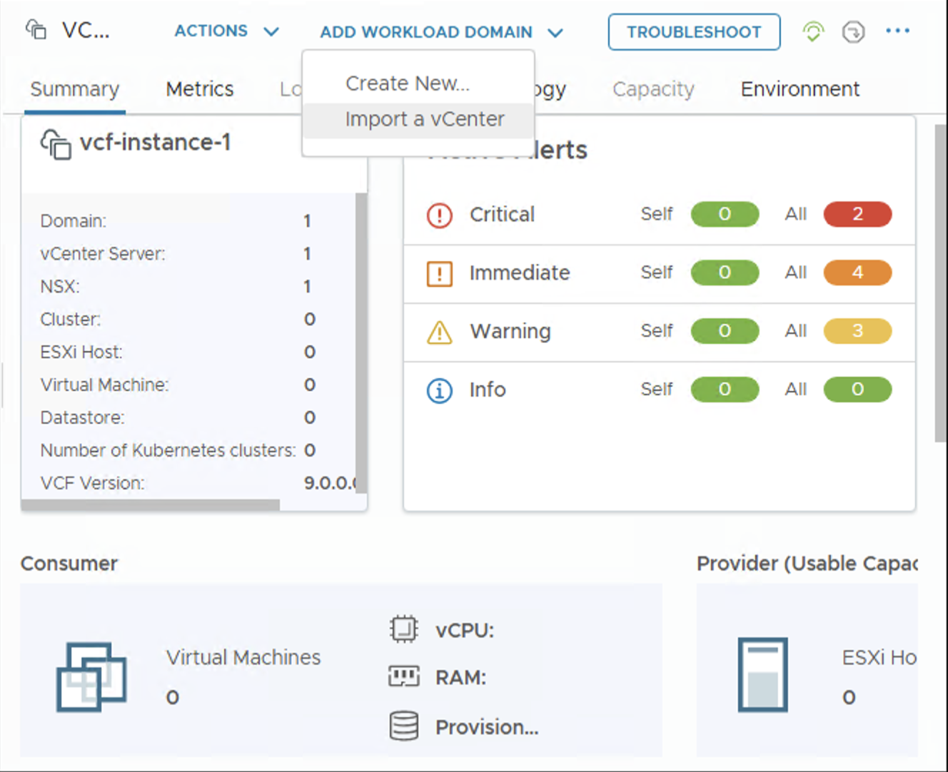
Deployment Pathways to Suit a Variety of Use Cases
VCF Operations workflows for workload domain deployment
VCF Operations:
Provides a new and integrated private cloud operations and management experience
Unified operations and management of compute, storage, networking, fleet management and lifecycle management
Inbuilt workflows to create new workload domains
External vCenter deployments can be imported into a VCF instance as workload domains for centralized management
V\
VCF 9.0
VMware Cloud Foundation
VCF Automation
VMware vSphere
Workload Domain
VCF Operations
Cluster 1
Cluster 1
Cluster 2
Cluster 2
vCenter Server
Cluster …N
NSX Manager
Cluster 1
Cluster …N
Core Infrastructure
Cluster 2
Cluster …N
External Deployment(s)
vCenter Server
NSX Manager
Core Infrastructure
Workload Domain
Cluster 1
Cluster 2
Cluster …N
vCenter Server
NSX Manager
Core Infrastructure
Notes:
Presenter Note: This slide contains animation
Key Message:
VCF 9 provides an integrated and unified operations experience (discussed in more detail later during this presentation).
VCF Operations can also be used to import pre-existing vCenter deployments into an existing VMware Cloud Foundation instance.
Talk Track:
From VCF 9 private cloud operations and management is performed using the VCF Operations Console.
VCF Operations provides cloud administrators with a unified and feature rich operations experience which spans compute, storage, networking, fleet management and lifecycle management.
VCF Ops for VCF 9 also includes inbuilt workflows supporting an additional two VCF deployment pathways.
You can use VCF Operations to create a new workload domain or…
<click 1>
VCF Operations can also be used to import additional (existing) vCenter deployments into an existing VMware Cloud Foundation instance for centralized management and operations.
<click 2>
In this instance each vCenter deployment is imported into the VCF Inventory as a workload domain.
VCF Operations will be discussed in more detail later in this presentation.
Notes: Importing additional vCenter deployments into VCF:
When importing a vCenter deployment into a VCF instance all clusters within the vCenter server are imported and configured as part of a workload domain. - vSphere clusters configured with/without vSAN, vSphere clusters configured with/without NSX and any combination of the 3 software components can be used when importing a vSphere cluster to an existing VCF instance from VCF Operations. NSX is deployed as part of the process if it is not already present. The SDDC Manager appliance is still present and can be used with VCF 9. SDDC Manager will be deprecated in a future release. Resources:

Slide 9
Centralize Management of External vCenter Deployments
Importing an existing vCenter deployment into VCF with VCF Operations
VCF Operations provides workflows to import externally managed vCenter environments into VCF
Eases private cloud adoption by centralizing management and operations which can reduce costs across disparate environments
Inbuilt workflows negate the need for workload migrations
Combinations of vSphere, vSAN and NSX can be imported
NSX is deployed as part of the process if it is not already present.
Import a vCenter
Notes:
Presenter Note: This slide contains animation
Key Message:
VCF 9 makes it easy to import existing infrastructure directly into Cloud Foundation.
Talk Track:
Let’s take a closer look at the options available within VCF Operations to centralize management of external vCenter deployments.
VCF Operations makes it easy to add existing vSphere, vSAN and NSX infrastructure into an existing VCF instance. VCF Operations provides guided workflows for importing pre-existing vSphere infrastructure into a VCF instance as workload domains.
The ability to import pre-existing infrastructure into VCF expedites the path to VCF by allowing customers to leverage existing investments while simultaneously reducing costs. In addition, with this capability customers no longer need to be concerned with having to migrate existing workloads from existing infrastructure to VCF.
When importing a vCenter deployment into a VCF instance all clusters within the vCenter server are imported and configured as part of a workload domain. vSphere clusters configured with/without vSAN, vSphere clusters configured with/without NSX and any combination of the 3 software components can be used when importing a vSphere cluster to an existing VCF instance from VCF Operations.
NSX is deployed as part of the conversion process if it is not already present.
Notes:
The VCF Import Tool was used in VCF 5.2.x to converge an existing vSphere cluster to a VCF management domain. It was also used to import a vSphere cluster into an existing VCF instance.
VCF Operations is used to import an existing vSphere cluster into an existing VCF 9.0 instance From the Inventory Menu > select your VCF instance > Add Workload Domain > Import a vCenter
Once complete the admin can then go in to enable VCF Ops Data Collection for the domain.
vSAN: The VCF Operations workflow to “Import a vCenter” in VCF 9 supports multiple vSAN deployment types
Single site cluster
Disaggregated storage clusters
Stretched clusters
2-Node clusters
Resources:

Slide 10
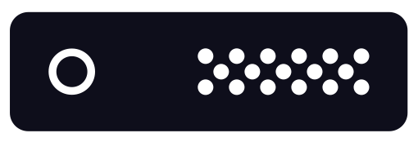
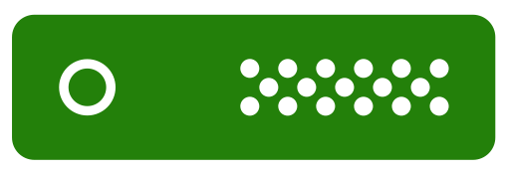
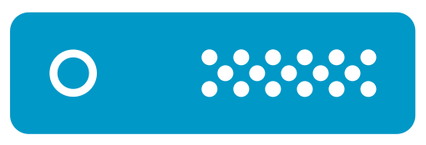

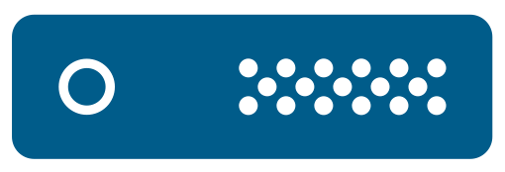
Easily Scale Private Cloud Infrastructure
Host Commissioning, Adding Clusters and Creating Workload Domains
Use the familiar vSphere client to scale your private cloud
Commission ESXi Hosts in bulk or individually to the Inventory
Network Pools configured for vMotion and Storage
Add unassigned hosts to new clusters or scale existing clusters
Create new workload domains using VCF Operations
Continue using SDDC Manager for Day N workflows
V\
Management Domain
VCF Automation
Workload Domain
Management Domain
VCF Operations
VCF Operations
VCF Automation
Cluster N
VCF Operations
Cluster 2
Cluster 1
Cluster…
Cluster 1
NSX Manager
vCenter Server
NSX Manager
vCenter Server
vCenter Server
vCenter Server
NSX Manager
Core Infrastructure
ESXi Hosts
Core Infrastructure
Core Infrastructure
Global Inventory
Notes:
Presenter Note: This slide contains animation
Key Message:​
The vSphere client is used to commission new hosts, add new clusters and scale clusters. VCF Operations can be used to deploy new workload domains.
Talk Track:
Scaling private cloud infrastructure is easy in VCF 9.
Utilize familiar workflows within the vSphere client to commission new ESX hosts into the Global inventory.
<click 1>
New hosts can be commissioned individually or in bulk using FQDN. Hosts can be commissioned into predefined network pools for vMotion and storage. Admins can select to commission hosts for a number of different storage types – vSAN, NFS and VMFS on FC. Each host is validated by confirming their fingerprint.
<click 2>
Commissioned hosts will be visible as unassigned hosts in the global inventory and can be used to create new clusters or scale existing clusters. Multiple host and cluster deployment and scaling operations can be performed in parallel to save time. Each cluster is deployed using a vSphere Lifecycle Manager image (vLCM image).
<click 3> VCF Operations contains streamlined workflows to create new workload domains. Each workload domain can be configured using its own software defined infrastructure which allows them to be individually managed, scaled, lifecycle managed, patched and upgraded independently.
<click 4> Continue using SDDC Manager for Day N workflows.
Notes: vSAN
vSAN is recommended when configuring a new cluster as it is flexible, quick to configure, easy to change and removes the need for manual configuration and potential disruption when storage changes or maintenance needed.
vSAN ESA and OSA architectures are supported.
ESX: - A new workload domain is deployed using dedicated ESX hosts configured in one or more clusters managed with it’s own vCenter server. Clusters can be configured with a choice of supported storage types.
NSX:
- Each host is deployed for virtual networking using NSX. Administrators can also configure advanced networking to best suit the needs of their applications by creating switch profiles, multiple Virtual Distributed Switches (which are prepared for NSX) and multiple pNICs.
The first workload domain is configured with a separate NSX instance to the management domain. Additional workload domains (2nd and so on) can be configured to use a new NSX instance or the NSX instance of an existing workload domain.
Infrastructure Management and Operations:
- VCF Operations contains in-built workflows to create new workload domains pre-configured with the vSphere Supervisor to support the configuration of Kubernetes workloads.
The vSphere client is used to commission new hosts into the VCF inventory, add hosts to an existing cluster or to add a new cluster. It can also be used to configured centralized network connectivity (using an NSX Edge cluster) or distributed networking connectivity.
- SDDC Manager is deprecated in VCF 9 and will not be available in a future release.
Resources:
- VMware Configmax site: https://configmax.esp.vmware.com/home

Slide 11
SDDC Infrastructure
COMPUTE | vSphere
Mixed Vendor Clusters
Memory Optimization with NVMe
Configure vGPU Profiles
Faster vMotion for GPU Workloads
Configure GPU Reservations
Live Patch for ESX
Virtual Hardware Version 22

Slide 12
Build Clusters Your Way
Mixed vendor clusters
Assign additional images manually or automatically
Multiple Hardware Support Managers (HSM) per cluster image
Up to 4 additional images can be created per cluster image
Support multiple server models in a single cluster image
Cluster Image
ESX Base Version
Additional Image
Cluster
ESX Host
Vendor Add-on
ESX Host
Firmware (HSM)
ESX Host
Components
ESX Host
ESX Host
Additional Image
ESX Host
Vendor Add-on
ESX Host
Firmware (HSM)
ESX Host
Components
Notes:
Key Message:
vSphere Lifecycle Manager supports mixed vendor clusters, as well as support for multiple hardware support managers per cluster. vSAN includes support for mixed vendor clusters.
Talk Track:
vSphere Lifecycle Manager supports mixed vendor clusters, as well as support for multiple hardware support managers per cluster. vSAN includes support for mixed vendor clusters.
Clusters can have up to 4 additional image definitions to make on a single composite image of the cluster. The base ESX version is static for all additional images and cannot be customized. The vendor addon, firmware, and components of each image definition can be customized to accommodate clusters with mixed hardware. Each additional image definition can have a unique hardware support manager (HSM) attached.
Additional images can be manually assigned to a subset of hosts in a cluster, or automatically using System BIOS information including Vendor, Model, OEM String and Family values. For example, you can have a cluster that consists of 5 Dell hosts and 5 HPE hosts where the Dell hosts can be assigned one image definition with Dell vendor addon and Dell HSM, and the HPE hosts can be assigned a different image definition with a HPE vendor addon and HPE HSM.
Notes:
Resources:

Slide 13
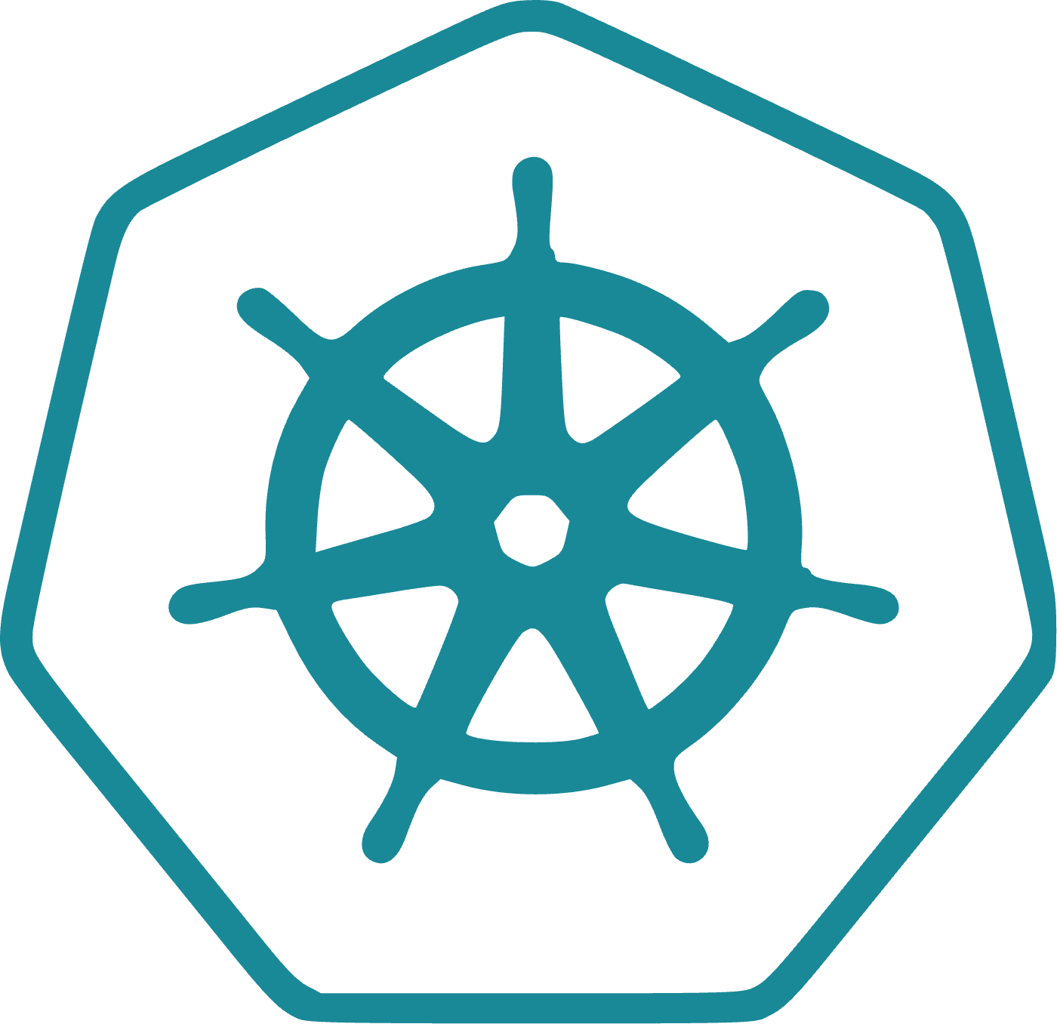
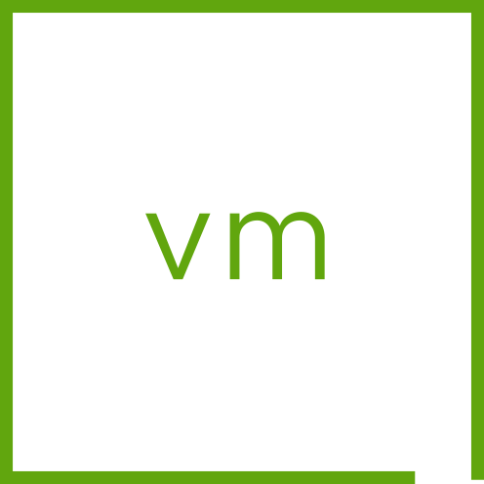


Scale Memory Capacity with Lower TCO
Memory optimization with NVMe
NVMe devices help optimize server resource usage
Addresses core-to-memory imbalance
More in-memory computing
Run more workloads with better CPU utilization!
ESX
Memory Hardware
DDR
NVMe
Notes:
Presenter Note:
Key Message: Memory Tiering leverages PCIe-based Flash NVMe devices to act as a second layer of memory, resulting in an increase of available memory within the ESX host.
Talk Track:
Utilize NVMe devices as tiered memory resources.
Memory Tiering leverages PCIe-based Flash NVMe devices to act as a second layer of memory, resulting in an increase of available memory within the ESX host. Memory tiering over NVMe lowers total cost of ownership (TCO) and increases VM consolidation by directing VM memory allocations to either NVMe devices or faster dynamic random-access memory (DRAM) in the host. This allows you to increase your memory footprint and workload capacity, while reducing the total cost of ownership (TCO).
vSphere 8.0 Update 3 launched with a tech preview the Memory Tiering capability and it is now GA with vSphere 9. This capability allows you to use NVMe devices that you can add locally to an ESX host as tiered memory.
Notes: Resources:

Slide 14
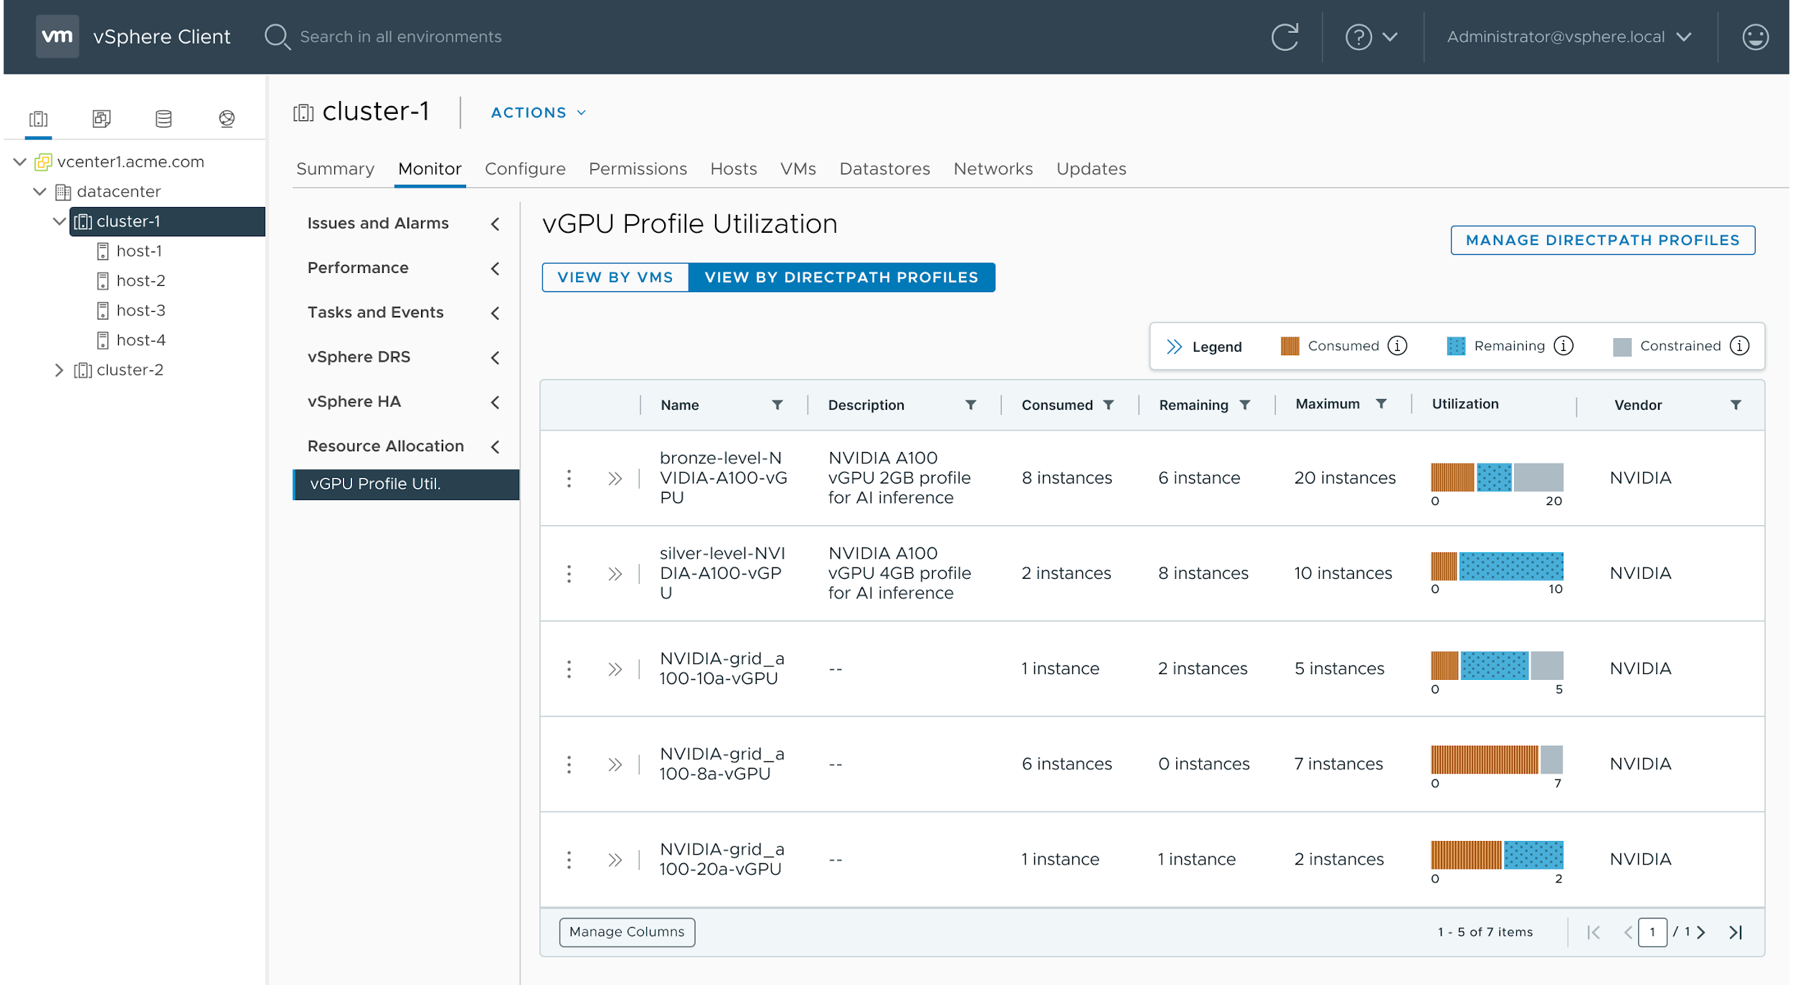
Improved Visibility of GPU Resources
Configure vGPU profiles from the vSphere client
Configure vGPU Profiles for improved visibility of valuable GPU resources
Allows admins to perform capacity assessment and planning of GPU resources
Once configured vGPU profiles can be viewed by Profile name or VM name
V\
Notes:
Key Message: Configure vGPU profiles from the vSphere client
Talk Track: GPU capacity in the modern data center is typically constrained as GPU resources are expensive and in high demand. Administrators often find it difficult to map consumed and remaining capacity of GPUs and vGPUs. vSphere 9 provides the capability to configure DirectPath Profiles. vGPU profiles provides capacity assessment and planning of GPU resources and is a basis for making decisions about how to mix workloads onto GPUs. Resources can be viewed by profile name or viewed by VM name and allows admins to also provide a descriptive detail on the GPU type and further context around how it is has been configured (GPU or vGPU, Time Sliced vs MIG).
We next move to a subject that builds on this vGPU visibility – the notion of reserving a quantity of GPU space ahead of time, so that the user has a guarantee that it is available when needed.
Notes:
A vGPU profile is assigned using the vSphere client to a powered off virtual machine.
Resources:

Slide 15



Increased Uptime for AI/ML Workloads
Faster vMotion for vGPU enabled VMs
The vGPU profile determines the GPU memory used in a VM
GPU 1
GPU 2
A vGPU Profile assigned to a VM allows vMotion of that VM
40GB vGPU profile
80GB vGPU
profile
Memory copy for the GPU contents is taking place during vMotion
Less than 1 second stun time for 8GB vGPU profile
Available
80GB GPU
40GB vGPU profile
80GB GPU
Available
Two VMs with 40GB profiles
One VM with an 80GB profile
Notes:
Key Message:
Faster vMotion and increased uptime for AI workloads. Up to 6x reduction in vMotion time for typical vGPU profile.
Talk Track:
Here we show the memory of a pair of GPUs here that is associated with different VMs via the vGPU profile that was given to those VMs.. There are several choices to pick from of vGPU profile for any model of NVIDIA GPU. When one of these vGPU-aware VMs is undergoing a vMotion to a new host, the GPU memory data contents must is copied from source host machine to destination machine.
vMotion pre-copy is a technique used to transfer the VM memory to another host with minimal downtime. It copies both cold and hot memory in multiple passes while the VM is still running, eliminating the need to checkpoint and transfer all memory during the downtime.
vGPU profiles allow for faster vMotion and increased uptime for AI workloads (up to 6x reduction in vMotion time for typical vGPU profile).
Notes:
This may mean that 80GB of data or more is copied during that time.
A vGPU profile is assigned using the vSphere client to a powered-off virtual machine. Resources:

Slide 16
Improved Capacity Planning of GPU Resources
Configure GPU reservations
AFTER
Accelerate Performance
New workload - 80GB vGPU profile
Advance reservation provides capacity on GPU 2
Raise performance and streamline operations
40GB vGPU profile
80GPU Reserved
GPU reservation guarantees capacity for a new VM
Assured power-on of a new VM
Available
80GB GPU
40GB vGPU profile
80GB GPU
Available
GPU1
GPU2
Note- GPU reservations need to be done as a group with memory and CPU reservations
Notes:
Key Message:
Reserve resource pools for AI applications for future capacity needs.
Talk Track:
Today, admins cannot reserve space for vGPUs for future use. This prevents them from allocating GPU space for Gen AI applications in advance, potentially causing performance issues when these applications are deployed.
GPU reservations allow admins to reserve resource pools for vGPU profiles ahead of time, for better capacity planning, and improving both performance and operational efficiency.
Notes: This feature is fully supported in VCF 9.0 as a Tech Preview
Resources:

Slide 17


Patch vSphere Clusters Faster and Less Disruptively
Live Patch even more of ESX
Live Patch vmkernel, user-space and NSX components
ESX service restarts required (non-disruptive)
Fast-Suspend-Resume remediates VMs
No Evacuation, VMs stay running
ESX
vmkernel
user-space
nsx
vmx
Notes:
Presenter Note: This slide contains animation
Key Message:
Live Patch is extended to more of the ESX image, including vmkernel and NSX components. Increasing the frequency that patches can leverage live patch.
Talk Track:
Live Patch for ESX was introduced with vSphere 8.0 Update 3 and is has now been extended to more of the ESX image, including vmkernel and NSX components. Increasing the frequency that patches can leverage live patch.
NSX components, now part of the base ESX image, can be patched using the live patch process without hosts entering maintenance mode and needing VMs to evacuate the hosts.
Vmkernel, user-space and vmx (virtual machine execution) components can also leverage live patch. ESX services (for example hostd) might require a restart during a live patch which can cause ESX hosts to briefly disconnect from vCenter. This is expected behaviour and does not impact the running virtual machines. vSphere Lifecycle Manager reports what services or daemons will be restarted as part of the live patch remediation.
If the vmx (virtual machine execution) environment is being live patches, running VMs will perform a Fast-Suspend-Resume (FSR). Live patch is compatible with vSAN clusters. vSAN witness nodes are not compatible with live patch and will undergo full reboots when patching.
Update releases (for example ESX 9 Update 1) are expected to require a full reboot as the entire ESX system is being updated.
Hosts using TPM and/or DPU devices are not compatible with live patching.
Notes:
1. Host enters partial maintenance mode
2. New mount revision loaded
3. New mount revision patched
4. VMs fast-suspend-resume to consume patched mount revision
Some virtual machines are not compatible with FSR. VMs configured with vSphere Fault Tolerance, VMs using Direct Path I/O and vSphere Pods cannot use FSR and need to be manually remediated. Manual remediation can either be done by migrating the virtual machine or by power cycling the virtual machine.
Virtual machines that do not support FSR include VMs configured for vSphere Fault Tolerance, VMs configured with VM DirectPath I/O devices, vSphere Pods (container pods).
These VMs must be manually migrated using vSphere vMotion or power cycled to pick up a new patched vmx instance.
Resources:

Slide 18



Virtualized Hardware Innovations
Virtual Hardware Version 22
Up to 960 vCPU
Latest CPU support
Latest Guest OS support
AMD SEV-SNP and Intel TDX
TPM Spec 2.0 Rev 1.59
New Guest Customization APIs
Virtual NVMe namespace write protection
TPM
Notes:
Presenter Note: This slide contains animation
Key Message:
Increased vCPU (960) limit for a virtual machine. Support new CPU models – AMD Zen 5 and Intel Granite Rapids. Talk Track:
Increased vCPU (960) limit for a virtual machine. Support new CPU models – AMD Zen 5 and Intel Granite Rapids.
New Guest OS versions for new VM deployments. (see Latest Guest OS Support below)
Support for AMD SEV-SNP (tech preview) and Intel TDX (tech preview) for virtual machines.
Virtual Trusted Platform Module (vTPM) supports Trusted Platform Module (TPM) Library Specification Family 2.0 Revision 1.59. ESX 9.0 supports TPM 2.0 specification Revision 1.59, aimed to enhance your cyber security protection as you add a vTPM device to a virtual machine with hardware version 22.
New Guest Customization vAPIs. The newly introduced CustomizationLive API interface allows users to apply a customization specification to a VM while it is in a powered-on state. Refer to the latest vSphere Automation API documentation for VCF 9.0.
The newly introduced Guest Customization API allows users to determine whether a VM can be customized before applying customization.
Virtual NVMe. vSphere 9 introduces Namespace Write Protection (a read-only disk) and Write Zeroes support. Namespace Write Protection allows users to hot-add independent-nonpersistent disks to a VM without incurring the overhead of delta-disk creation. Workloads needing faster application delivery would benefit from this capability. Write Zeros support provides better performance, improves storage efficiency, and enhances data management capabilities for various workloads.
Notes:
Latest Guest OS Support
Pardus, Red Hat Core OS, Miracle Linux, ProLinux, Kylin Linux, FusionOS, RHEL 10, Oracle Linux 10, Debian 13, FreeBSD 15
Monster VM Limits
Support up to 960 vCPU and 24TB Memory for a virtual machine.
Resources:

Slide 19
SDDC Infrastructure
STORAGE | vSAN
vSAN Cluster-wide Deduplication
vSAN Storage Cluster Traffic Separation
Improved Scalability with vSAN File Services
vSAN Stretched Cluster Enhancements
Notes:
vSAN Cluster-wide Deduplication
vSAN Storage Cluster Traffic Separation
Improved Scalability with vSAN File Services
vSAN Stretched Cluster Enhancements

Slide 20
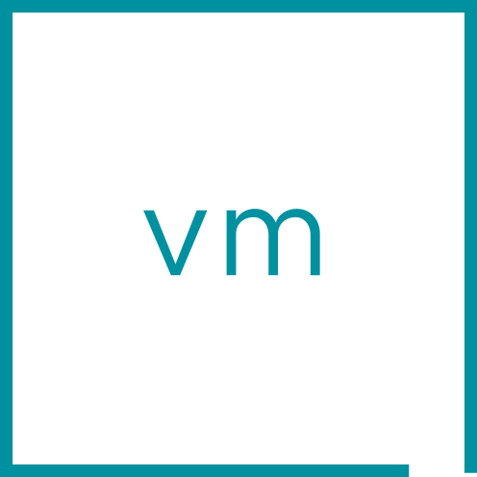
Additional Space Efficiency Reducing Cost Per TB
Cluster-wide deduplication in vSAN ESA as a part of VCF 9.0 (Limited Availability)
Capacity Overview
Effective. Optimized for maximum space efficiency
Uses 4KB granularity
Cluster-wide dedup domain
Runs asynchronously
Adaptive throttling
Minimal performance impact
vSAN data services integration
Compression
Snapshots and clones
Erasure coding & mirroring
Data-in-Transit encryption
Used 181 TB/905 TB (20%)
Actually Written
Space efficiency savings:
314 TB (Ratio: 4.73x)
vSphere
vSAN ESA
Frees capacity
Background
deduplication
process
vSAN ESA Datastore
Notes:
Presenter Note: This slide contains animation
Key Message/Talk track:
VCF 9.0 introduces deduplication when using vSAN ESA. This is a cluster-wide deduplication technology that is designed for maximum levels of space efficiency with minimal impact on guest VM workloads. The intelligent design of ESA’s deduplication technology will adaptively throttle the use of spare resources so that there is not a compromise in performance of guest VM workloads. Furthermore, deduplication’s integration throughout the storage stack means that the common vSAN data services are fully compatible with deduplication. This includes compression, snapshots and clones, erasure coding, check summing, and so on. The new deduplication capabilities in VCF 9.0 will drive down your total cost of ownership to levels not previously possible.
----------------------------------
Overview:
Effective. Optimized for maximum space efficiency
Uses 4KB granularity
Cluster-wide dedup domain
Runs asynchronously
Adaptive throttling
Minimal performance impact
Integrated with other vSAN data services
Compression
Snapshots and clones
Erasure coding & mirroring
Data-in-Transit encryption
----------------------------------
Details:
The implementation of deduplication in vSAN OSA was reflective of capabilities and limitations of that architecture. As a result, deduplication boundaries (domains) were limited to disk groups, which reduced the effectiveness of deduplication. The deduplication processes occurred when the data was destaged to disk, which tended to slow the destaging process, and eventually introduced latency on the guest VM.
vSAN ESA allows us to approach deduplication in a different way. It does not share any characteristics with the approach used by vSAN OSA and will demonstrate much higher deduplication savings while minimizing any impact on workloads. It is also fully integrated to work with a variety of other vSAN data services and features. Including, but not limited to:
Compression
vSAN Data-at-Rest Encryption (not supported in this release)
vSAN Data-in-Transit Encryption
Snapshots and clones
RAID-5/6 erasure coding and RAID-1 mirroring
vSAN File Services
Notation of savings or space efficiency capabilities (deduplication, compression, or both) compressibility can be easily conflated with the different methods of stating its absolute efficiency, or its efficiency relative to the previous implementation of compression. For example:
Expressed as a ratio. [starting unit size]:[ending unit size]. A ratio of 10:1 would indicate that data that would otherwise consume 100TB would only consume 10TB after the space efficiency techniques are applied.
Expressed as a multiplier of reduction. A multiplier of 10x would indicate that data that would otherwise consume 100TB would only consume 10TB after the space efficiency techniques are applied.
Expressed as a percentage of original size: A percentage of 10% would indicate that data that would otherwise consume 100TB would only consume 10TB after the space efficiency techniques are applied.
Expressed as a percentage of savings: A percentage of 90% would indicate that data that would otherwise consume 100TB would only consume 10TB after the space efficiency techniques are applied.
vSAN uses the multiplier of reduction (or savings) notation, thus, the following multipliers can mean:
2x multiplier of reduction means that consumption is just 50% of the original size, and a savings of 50%
4x multiplier of reduction means that consumption is just 25% of the original size, and a savings of 75%
8x multiplier of reduction means that consumption is just 12.5% of the original size, and a savings of 87.5%
See other slide for additional details
The debut of vSAN ESA saw significant improvements immediately after its initial release in 8.0. This was a result of optimizations that were not completed in time to ship in the initial GA version. The deduplication feature of ESA will be similar. Not all of its design characteristics will not be implemented when it debuts, but will be expected to show significant enhancements with the versions following thereafter.
This feature will initially debut in a limited availability in vSAN 9.0 P01 via Broadcom’s “Technical Qualification Request” (TQR) replaces VMware’s “Request for Product Qualification” (RPQ) for features that are not generally available. To submit a TQR, please contact vSAN Product Management. It will likely be a full feature in a release sometime after 9.0.
In general (for most storage systems), the effectiveness of deduplication is highly dependent on several factors, including but not limited to:
Design of deduplication system. Storage systems often must be designed with a tradeoff of effectiveness versus effort. For example, a system designed for the best possible levels of deduplication (e.g. not a single duplicate of a matching block across the dedup domain) may have too high of an overhead due to the costly algorithms and metadata management. The additional space efficiency could have diminishing returns on space savings yet impact the performance in a manner that is not worth the capacity savings. This is what drives different approaches to deduplication within storage solutions. Deduplication in vSAN ESA was designed for high levels of deduplication with minimal impact on workload performance.
Likeness of data. A fragment of data must be the exact same for it to be deduplicated. If none of the blocks of data are the same, the blocks cannot be deduplicated. This is why some storage systems lose their ability to deduplicate data that is encrypted prior to being stored, since encrypted data always creates a unique hash. vSAN has historically been able to maintain effectiveness even when data is encrypted using vSAN Data-at-Rest encryption. Data-at-Rest Encryption is not yet supported for this initial release of deduplication on vSAN ESA.
Characteristics of data and workloads. Different applications and data sets may result in data that is or is not very well suited for deduplication. Structured data like databases typically have lower deduplication rates than unstructured data, such as flat file storage consisting of various data types. Some workload patterns such has high data change rates could also impact deduplication effectiveness, as the deduplication system may interact with high data change rates differently.
Size/granularity of deduplication: Does a system analyze data in larger chunks or smaller chunks. This will impact the level of effectiveness with deduplication. vSAN ESA deduplicates at a small 4KB block level, increasing the chances of matches, and improving deduplication ratios.
Amount of data within the deduplication domain. A small amount of data may proportionally not have as many opportunities to deduplicate as a large amount of data. Generally, the larger amount of data, the better the chances are that it can be deduplicated. As a result, deduplication rates will often increase at a super-linear rate.
Limitations
Deduplication will initially be limited to vSAN ESA clusters running vSAN 9.0 P01, with customers submit a TQR and are approved for using the feature. When customers qualify, there will be additional requirements, including but not limited to:
25Gb or faster networking
Maximum cluster sizes of no greater than 16 hosts
Telemetry (CEIP) data enabled.
The support of stretched clusters, 2-Node clusters and data-at-rest encryption will not be available upon initial release in VCF 9.0 P01
Deduplication is not supported with clusters running vSAN data-at-rest encryption. This is targeted for a later release.
Positioning
The official marketing term is “vSAN Global Deduplication” and should be used in marketing communication. However, “cluster-wide deduplication” can be used as a more accurate descriptor of the technology, and may be more helpful to customers who are trying to understand technology.
The official marketing collateral for vSAN global deduplication will cite a few claims that are worthy of further explanation:
“Up to 8x capacity reduction.” This is an approved claim from Engineering under certain qualifying conditions. It could be more, or it could be less depending on the circumstances, and will depend heavily on data type. The claim will generally include the use of ESA’s compression feature enabled.
“TCO savings of 34% and $10M USD.” This is based on a modeled organization of 10,000 VCF cores.
In general messaging, we try not to shorten the word “deduplication” when space allows the full word. When it does not, it should be shortened to “dedup” (with no “e”)
Deduplication exists to lower the total cost of storage. vSAN ESA uses a cluster-wide deduplication strategy that drives down the cost of storage while minimizing any impact on the running workloads.
The initial limited availability of this feature is so that Broadcom resources can carefully evaluate the deployment of deduplication in various customer environments. This proactive approach allow our engineering teams to ensure configuration and eligibility requirements when in-product guardrails for its initial release may be somewhat limited.
The cautious, proactive approach we are taking with deduplication also helps minimize potential issues that may arise in customer environments. These potential issues may or may not even be related to vSAN, but could impact the success of the feature.
Other storage solutions will advertise their own unique way to approach deduplication. What matters is effectiveness, and potential impact on running workloads.
Feature value in one sentence. Cluster-wide deduplication offered by vSAN can dramatically reduce the cost of storage, while minimizing impact any impact on running workloads and operational complexity in their environment.
Common Use Cases.
General purpose workloads
Performance focused tier-one applications
Large data lakes
VDI
----------------------------------
Additional Information:
TBD

Slide 21

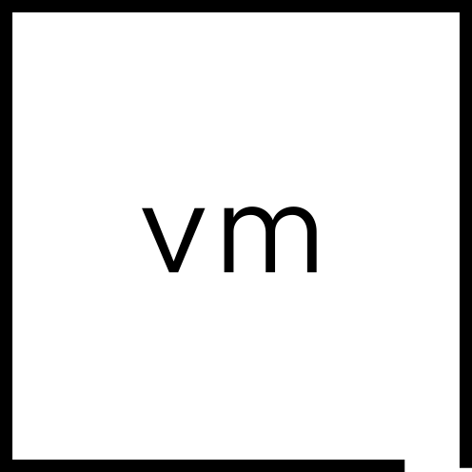
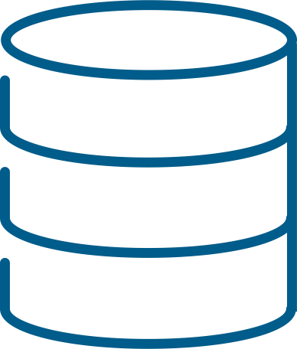
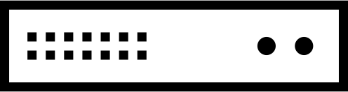

Faster Performance and Reduced Network Traffic
Network traffic separation for vSAN storage clusters in VCF 9.0
vSphere client clusters
vSAN cluster traffic isolated from vSphere clusters accessing datastore of vSAN storage cluster
Dedicated VMkernel interfaces for:
vSAN cluster traffic
vSphere client clusters mounting vSAN storage cluster datastore
Improves performance and simplifies management
Minimizes network traffic to/from client clusters
Compressed
Isolated
vSphere host configuration
VMkernel ports
vmk1 - vSAN client
vmnic1
vmnic3
Guest VM I/O
Guest VM I/O
10Gb ToR
Guest VM I/O
25/100Gb ToR
vSAN host configuration
VMkernel ports
vmk2 - vSAN
vmk3 - vSAN client
vSAN
vmnic1
vmnic3
Data/replica data
Resynchronization traffic
Metadata updates
East/west vSAN cluster traffic
vSAN storage cluster
Notes:
Presenter Note: This slide contains animation
Key Message/Talk track:
New to vSAN storage clusters in VCF 9.0 is the ability to separate the back-end storage network traffic of the vSAN storage cluster from the front-end traffic used by the vSphere clusters mounting the datastore. Separating traffic reduces the amount of communication to and from the vSphere clusters and keeps all of the east/west traffic for the vSAN storage cluster within its own network. Why is this important? If the vSAN storage cluster resides in a single rack, this means that all vSAN storage cluster traffic can be serviced by high-performing switches, with no need to leave the Top of Rack (ToR). Network traffic separation with vSAN storage clusters allows you to deploy, and optimize a vSAN storage cluster with minimal investment, and make it easier to adapt to environments running older networking.
----------------------------------
Overview:
vSAN cluster traffic isolated from vSphere clusters accessing datastore of the vSAN storage cluster
Uses dedicated VMkernel interfaces for:
vSAN cluster traffic
vSphere client clusters mounting vSAN storage cluster datastore
Improves performance and simplifies management
Minimizes network traffic to/from client clusters
Compressed
Isolated
----------------------------------
Details:
Historically, vSAN has always transmitted vSAN traffic over a single VMkernel interface. This was a reasonable approach for aggregated vSAN HCI clusters, but not ideal for disaggregated vSAN storage clusters. In a disaggregated environment, a single VMkernel interface meant that client cluster traffic would be sharing the same logical network as the vSAN cluster, which is responsible for all types of traffic, such as replica traffic, resynchronization traffic, and other metadata activities.
VCF 9.0 introduces a capability to separate traffic types when configuring a vSAN storage cluster. Hosts within a vSAN storage cluster can use VMkernel interfaces that are tagged for vSAN storage cluster traffic or tagged for cluster client traffic. This will allow for logical separation by using two discrete VMkernel interfaces, and optionally for physical separation by using separate, dedicated uplinks for vSAN storage cluster traffic.
The network traffic separation may be depicted using separate physical uplinks than the client cluster traffic. While this may be ideal, it is not a hard requirement. If a host is limited by the number of uplinks (1 NIC with 2 ports) there can be benefits of using network traffic separation feature on a single NIC. Multiple VMkernel interfaces are much more efficient, and when they are separated, one can use their own respective VLANs that will keep the traffic limited to the ToR leaf switches.
When using network traffic separation, if there is only one 2 port NIC on the server, the vSAN client traffic can reside on the same uplink used by the vMotion VMkernel port, while the other port is used for vSAN traffic. Since hosts in vSAN storage clusters will have very few to no VM instances running on the storage cluster, the vMotion VMkernel may have very little to no load.
When using this capability, the front-end traffic to and from the guests is somewhat analogous to a vSphere cluster mounting a datastore from a storage array via iSCSI. Note however that even though the topology is disaggregated, our native vSAN stack is used for the maximum amount of efficiency, flexibility, and performance. See the “Disaggregation and vSAN Storage Clusters” presentation for more details.
Traffic separation will also allow a vSAN storage cluster to use RDMA over Converged Ethernet (RoCE v2). This would be applicable to the back-end vSAN network only. Enabling vSAN on RDMA does require additional considerations and settings.
Internal testing has demonstrated up to 25% performance improvement when configuring a vSAN storage cluster with network traffic separation. The actual improvements will vary depending on the customer environment, hardware and networking, workloads, etc.
Limitations
VCF workflows may impose additional restrictions.
Positioning
Network traffic separation helps our customers deploy vSAN storage clusters in a manner that is more analogous to iSCSI or Fibre Channel arrays that have a dedicated storage fabric.
Feature value in one sentence. Network traffic separation helps drive better performance and be more accommodating for our customer’s network topologies.
Common Use Cases.
Driving better storage performance for vSphere hosts consuming vSAN storage.
Existing environments who want to integrate vSAN storage clusters into existing environments with legacy networking.
Customers who have stricter security requirements.
----------------------------------
Additional Information:
Design and Operational Guidance for vSAN Storage Clusters: https://www.vmware.com/docs/vmw-vsan-storage-clusters-design-and-operations

Slide 22
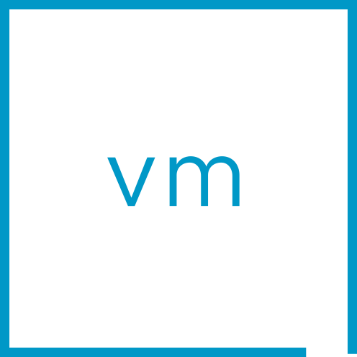

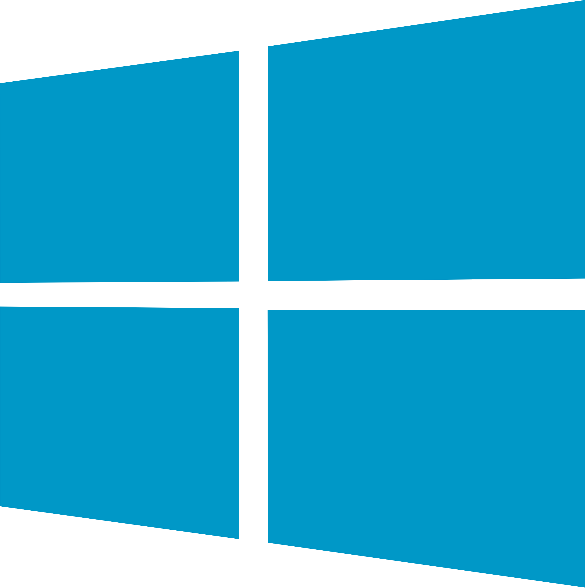


Improved Scalability with vSAN File Services in vSAN ESA
Support of up to 500 file shares per cluster in vSAN File Services
Windows clients
Linux clients
Persistent volumes (RWX) for Containers
2x increase in number of shares supported per cluster in vSAN File Services
Beneficial to all use cases
Cloud native workloads using RWX persistent volumes
NFS or SMB shares for guest VMs
NFS or SMB for legacy physical servers
Cluster limit can be a combination of NFS and SMB shares
No greater than 100 SMB shares per cluster
(100 max)
SMB
NFS
NFS
500 shares per cluster
vSphere
File Services
vSAN ESA
vSAN Cluster
Notes:
Presenter Note: This slide contains animation
Key Message/Talk track:
vSAN in VCF 9 improves its native file services by increasing the maximum number of shares per cluster. Now, customers can create as many as 500 shares per cluster, up 250 per cluster from the previous release, and 100 shares per cluster in versions prior. This enhancement is specifically targeted at customers who use NFS exports for a variety of use cases. Whether one chooses to use vSAN file services for departmental file shares, project collaboration, or sophisticated microservices architecture using persistent volumes, the increase scalability will help deliver these capabilities with room to grow.
----------------------------------
Overview:
2x increase in number of shares supported per cluster in vSAN File Services
Beneficial to all use cases
Cloud native workloads using RWX persistent volumes
NFS or SMB shares for guest VMs
NFS or SMB for legacy physical servers
Cluster limit can be a combination of NFS and SMB shares
No greater than 100 SMB shares per cluster
----------------------------------
Details:
vSAN File Services was initially limited to a maximum of 100 shares per cluster in its debut in vSAN 7. While this initial limit was sufficient for simple environments with modest needs, it was not sufficient for environments with workloads that required a lot of shares, such as persistent volumes for cloud native workload, or multi-tenant environments. Since the limit is per cluster, the 100 share limit was especially difficult for environments that were comprised of vSAN clusters with larger host counts, as these typically provided larger capacity, and thus, a need for more shares.
vSAN 9 increases the limit of shares per cluster to 500. This will primarily benefit clusters that more NFS based shares (NFS exports), as a limit of 100 shares will remain for SMB connections.
Depending on the circumstances, a container may be responsible one ore more shares. (Note that it is the container running inside of a FSVM that provides the file service presentation layer, and not the FSVM.) In vSAN 9, each container vSAN instantiates for file serves may be responsible for up to 50 shares (up from 25 in vSAN 8 U3), essentially serving as the mechanism for scaling the quantity of shares supported. For example, a 4 node vSAN cluster with 8 containers running as file servers would be able to provide 400 shares for the cluster.
Adding static IP addresses for File Services:
Edit > Edit Domain. Networking page will list the static IPs used. Simply add a static IP as desired.
The behavior of containers, and the scalability of the shares is also applicable to stretched clusters. However, with the ability to set affinity of a share on one site or the other, one may need more container file servers on each site to support the necessary number of shares during fully operational or failure conditions.
In some circumstances there can be a potential for a failover of containers to other hosts that eventually creates an imbalance across the hosts in the cluster, which will trigger a warning. For deployments running NFS, this warning can be disregarded, but with any blend of SMB and NFS shares, the containers may need to be manually rebalanced.
You can view where containers are created on the FSVMs by performing the following on EACH FSVM in the cluster.
In vCenter Server, highlight cluster
On VM under “ESX agents” click a vSAN File Services node
Click “Launch Web Console” and click “Yes.”
On console tab, log in as root/vmware
Enter: docker ps
See “created time” for all containers.
More shares supported and used will generally equate to more memory used on the hosts, but this may be largely imperceptible.
Support of the new limit is contingent on the following prerequisites.
vCenter Server updated
All ESX hosts in cluster updated
The Disk Format Conversion (DFC) upgraded. Reported in UI.
Any remaining updates via the File Services VMs (FSVMs). Reported in UI.
Common use cases for vSAN File Services under this expanded support of file shares
General purpose file shares – flat file storage
User home directories
Application data
Content repositories. Videos, images, etc.
Backup and archival
Edge/remote office scenarios
vSAN 9.0 does introduce the use of 10P for NFS servers. This will help with metadata handling, and will make noticeable improvements in performance.
The support of up to 500 shares per cluster is for both aggregated vSAN HCI clusters and disaggregated vSAN storage clusters.
Additional optimizations help reduce memory consumption in found in file services for vSAN 8 U3.
Limitations
This enhancement is limited to vSAN File Services running on a cluster powered by vSAN ESA only. It is not applicable to clusters running OSA.
While the total number of shares supported has increased, the limit for SMB shares remains at 100 per cluster (hard limit). This should be sufficient in many cases since many of the scenarios for higher share counts related to the use of persistent volume.
The containers themselves have a hard limit of 50 shares per container, but more than one container can be running on the host. This is considered an implementation detail, and not something the customer needs to focus on.
1,000 NFS connections per container. Note that nuanced limitations of vSAN file services generally are not publicized for a variety of reasons, but limits such as the connections per container may be accounted for in updated health checks.
Positioning
Feature value in one sentence. The improved scalability of vSAN File Services in vSAN ESA will give VMware Cloud Foundation environments a much greater ability to support their file sharing requirements.
Common Use Cases.
Cloud native workloads using RWX for persistent volumes
NFS or SMB shares for guest VMs
NFS or SMB for legacy physical servers.
----------------------------------
Additional Information:

Slide 23
Improved Flexibility, Operations and Uptime for Stretched Clusters
Support for vSAN storage clusters and new site maintenance and site takeover capabilities
Stretched vSphere and vSAN storage clusters
Stretched cluster site-wide maintenance mode
Stretched cluster manual site takeover
Failure
vSphere cluster
Maintenance
Maintenance
Takeover
Failure
vSAN storage cluster
vSAN HCI cluster
vSAN HCI cluster
Site
Site
Site
Site
Site
Site
Site resilience of compute and disaggregated storage
Easily place an entire site into maintenance mode
Self-service way to regain site availability after a severe outage
Notes:
Presenter Note: This slide contains animation
Key Message/Talk track:
vSAN stretched clusters are an extraordinarily popular topology deployed by a large percentage of our customers. Stretched clusters have proven to be an easy and reliable way to achieve site-level resilience without some of the complexity associated with metro storage clusters using storage arrays. For VCF 9.0, vSAN introduces new features that improve the flexibility, uptime, and operational tasks for stretched clusters. First, is the support of stretched compute clusters mounting the datastore of a stretched vSAN storage cluster, making stretched clustering for vSphere clusters easy. Next, the new site-wide maintenance capability takes the concept of “maintenance mode” to the site level for a stretched cluster. And third, the manual site takeover feature gives the administrator a self-service way to recover a single site in the event of a severe double site failure of a stretched cluster. We’ll elaborate on these features in the following slides, but you can already see how these enhancements show our commitment to making stretched clusters flexible and resilient for all of our customers.
----------------------------------
Overview:
Stretched vSphere and vSAN storage cluster
Site resilience of compute and disaggregated storage
Site-Wide Maintenance
Easily place entire an entire site into maintenance mode
Manual Site Takeover
Self-service way to regain site availability after a severe outage
----------------------------------
Details:
While vSAN stretched clusters have been extremely popular with our customer base, two of the most common requests often came up. Is there a way to recover the one remaining data site if I have a severe outage that takes out the two other sites simultaneously? And is there a way that I can perform site maintenance in my stretched cluster? In the event of a simultaneous double site failure, there was no way for customers to bring the one remaining site back online without contacting Global Support Services (GS). Even then, this was a time consuming, manual process performed by the SRE. Site-wide maintenance could be preformed by the administrator, but it involved several manual steps that were prone to error.
vSAN in VCF 9.0 helps address these two use cases with the manual site takeover and site wide maintenance mode respectively. We also enhance vSAN storage clusters so that vSphere clusters can also be stretched.
For more detailed information on these two new capabilities, see the dedicated slides for each respective feature.
The “site-wide maintenance mode” feature uses some of the framework used by the “manual site takeover” feature but does so in the “non-destructive mode.” This is what allows for proper data consistency during the maintenance mode event, and the graceful exiting from maintenance mode when the tasks are complete.
Broadcom’s “Technical Qualification Request” (TQR) replaces VMware’s “Request for Product Qualification” (RPQ) for features that are not generally available. To submit a TQR, please contact vSAN Product Management.
Limitations
For more detailed information on these two new capabilities, see the dedicated slides for each respective feature.
The site-wide maintenance mode and manual site takeover capabilities are only supported in vSAN OSA at this time.
Positioning
These two features help use fill the gap against array-based solutions set up in a metro storage cluster. Even though those can be complex to deploy and operate, these were often two capabilities that were available with array-based solutions.
Feature value in one sentence. Manual site takeover and site-wide maintenance make vSAN stretched clusters, and more resilient.
Common Use Cases.
(See feature specific slides)
----------------------------------
Additional Information:
TBD

Slide 24
SDDC Infrastructure
NETWORKING | NSX
Simple Networking with Virtual Private Clouds
Consume VPCs in vCenter and VCF Automation
Easily Deploy NSX Edges
Independent Connectivity Options for each Tier
External Connectivity with Centralized Services
External Connectivity with NSX Edges
High Performance Switching (EDP)
Notes:
Simple Networking with Virtual Private Clouds
Consume VPCs in vCenter and VCF Automation
Deploy NSX Edges Easily
Independent Connectivity Options for each Tier
External Connectivity with Centralized Services
External Connectivity with NSX Edges
High Performance Switching (EDP)

Slide 25


Simple Networking with Virtual Private Clouds (VPCs)
Consistent implementation of Virtual Private Clouds (VPCs) across the platform
PHYSICAL NETWORK
Resources pre-provisioning
VCF with NSX
Required Networking Expertise
Clear role definition allows self-service networking
Enterprise Admin:
Owns the physical infrastructure
Project Admin:
A tenant
No direct access to physical network
VPC Admin:
End user
Simple, self-service networking
IP blocks/quotas
Configures N/S connectivity
Creates projects, external IP blocks
Assigns IP blocks and quotas to projects
Enterprise Admin
advanced
Project
Creates VPCs
Assigns IP blocks and quotas to VPCs
Project Admin
basic
VPC
VPC
Required Networking Expertise
Creates subnets from pre-allocated IP blocks
Attach VMs
VPC Admin
minimal
subnet
subnet
Self-service resources consumption
Notes:
Presenter Note: This slide contains animation.
Key Message:
Virtual Private Cloud configuration is split into multiple roles, matching the different responsibilities required in a multi-tenant environment.
One of the main benefit of this model is that it shields VPC admin (a VI admin for example) from complex networking configurations that are pre-configured by the upper tiers (enterprise admin/project admin.)
Talk Track:
A Virtual Private Cloud, or VPC, is a logically isolated, tenant-specific virtual network that provides dedicated routing, switching, and security services.
In VCF 9.0, VPCs are implemented consistently across the entire platform—not just within NSX.
This model defines clear roles to support multi-tenancy and enables self-service capabilities for end users.
The first role is the Enterprise Admin, who owns the VCF infrastructure and manages the connection to the physical network.
<click 1>
The Enterprise Admin is responsible for coordinating with the physical network to ensure proper connectivity.
They also create "projects," which represent the first level of tenancy, and define external IP blocks that allow communication between the virtual and physical networks.
These external IP blocks are then distributed to the individual projects, and quotas can be applied as needed. Importantly, the Enterprise Admin maintains full control over all networking resources.
<click 2>
Next, the Project Admin steps in to manage the resources delegated by the Enterprise Admin, but without direct access to the physical infrastructure.
<click 3>
The Project Admin is responsible for creating and managing VPCs, which represent the second level of tenancy.
They also allocate resources, such as IP pools, and apply quotas to individual VPCs.
<click 4>
Finally, we have the VPC Admin, who acts as the end user in this model.
The VPC Admin can independently create virtual networks—called subnets—
and easily attach workloads to these networks.
<click 5>
A key benefit of this model is that the VPC Admin can fully leverage networking services without requiring in-depth networking expertise.
This is possible because the Enterprise and Project Admins pre-configure the underlying network and resource allocations, enabling true self-service with minimal need for additional support.
Notes:
Resources:

Slide 26
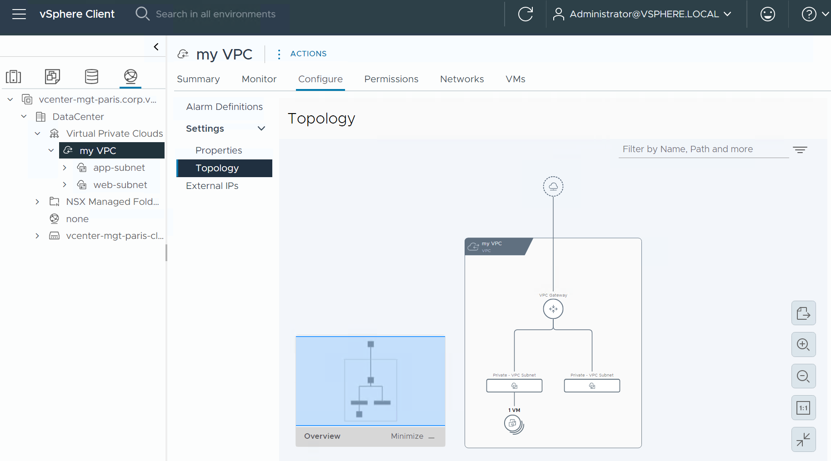
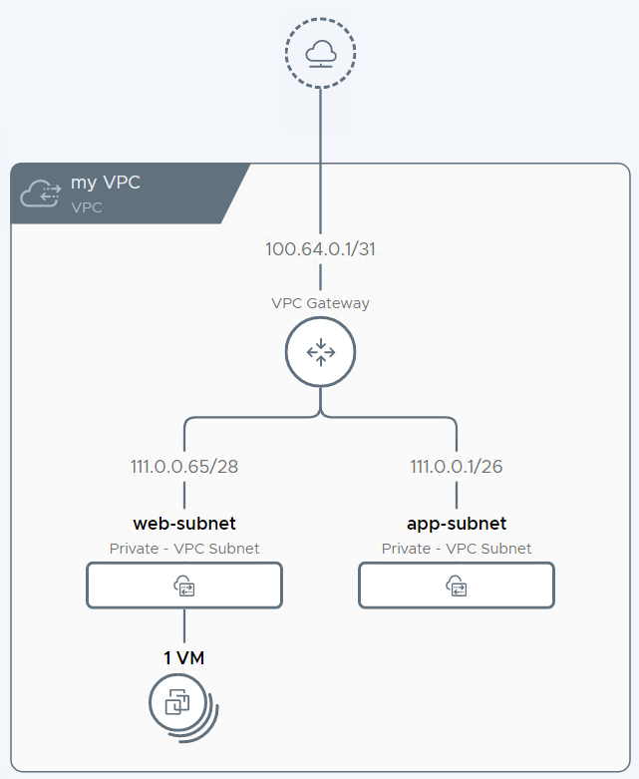
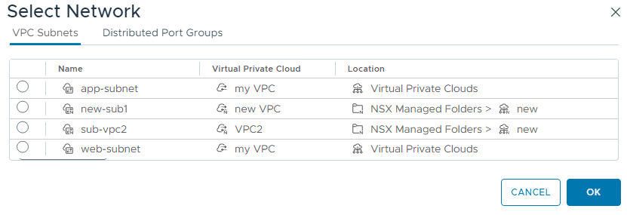
Consume VPCs in vCenter and VCF Automation
Consistent implementation of Virtual Private Clouds (VPCs) across the platform
VPCs can be configured directly from vCenter and VCF Automation
VPCs and subnets are first-class objects
Attaching a VM to a subnet is straightforward
Notes:
Presenter Note: This slide contains animation
Key Message:
With VCF 9.0, VPCs are fully integrated across the platform, exposed as first-class objects in vCenter where the default project is fully configurable by the vCenter Admin, who can easily connect VMs to subnets or DVPGs directly from the UI.
Talk Track:
The VPC concept has long existed within NSX, but with VCF 9.0, it is now fully integrated and consumable across other components of the platform.
VCF automation leverages VPC objects, and VPCs are now exposed as first-class objects directly within vCenter.
By default, NSX creates a default project that is fully configurable by the vCenter Admin, who in this case serves as the Enterprise Admin, Project Admin, and VPC Admin all at once.
Other, non-default projects appear in vCenter as read-only and cannot be modified from there.
<click 1>
vCenter also displays subnets directly in the UI, allowing you to easily connect a VM to a subnet, similar to how you would attach a VM to a DVPG.
In fact, both options are available side by side in the interface.
Notes:
Resources:

Slide 27
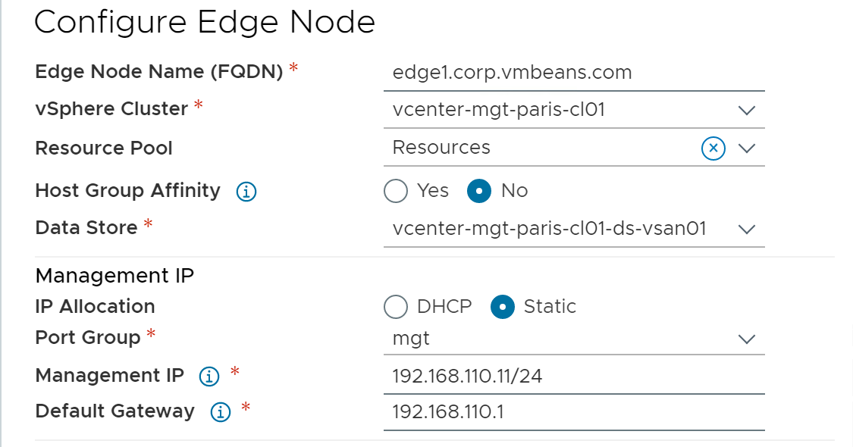
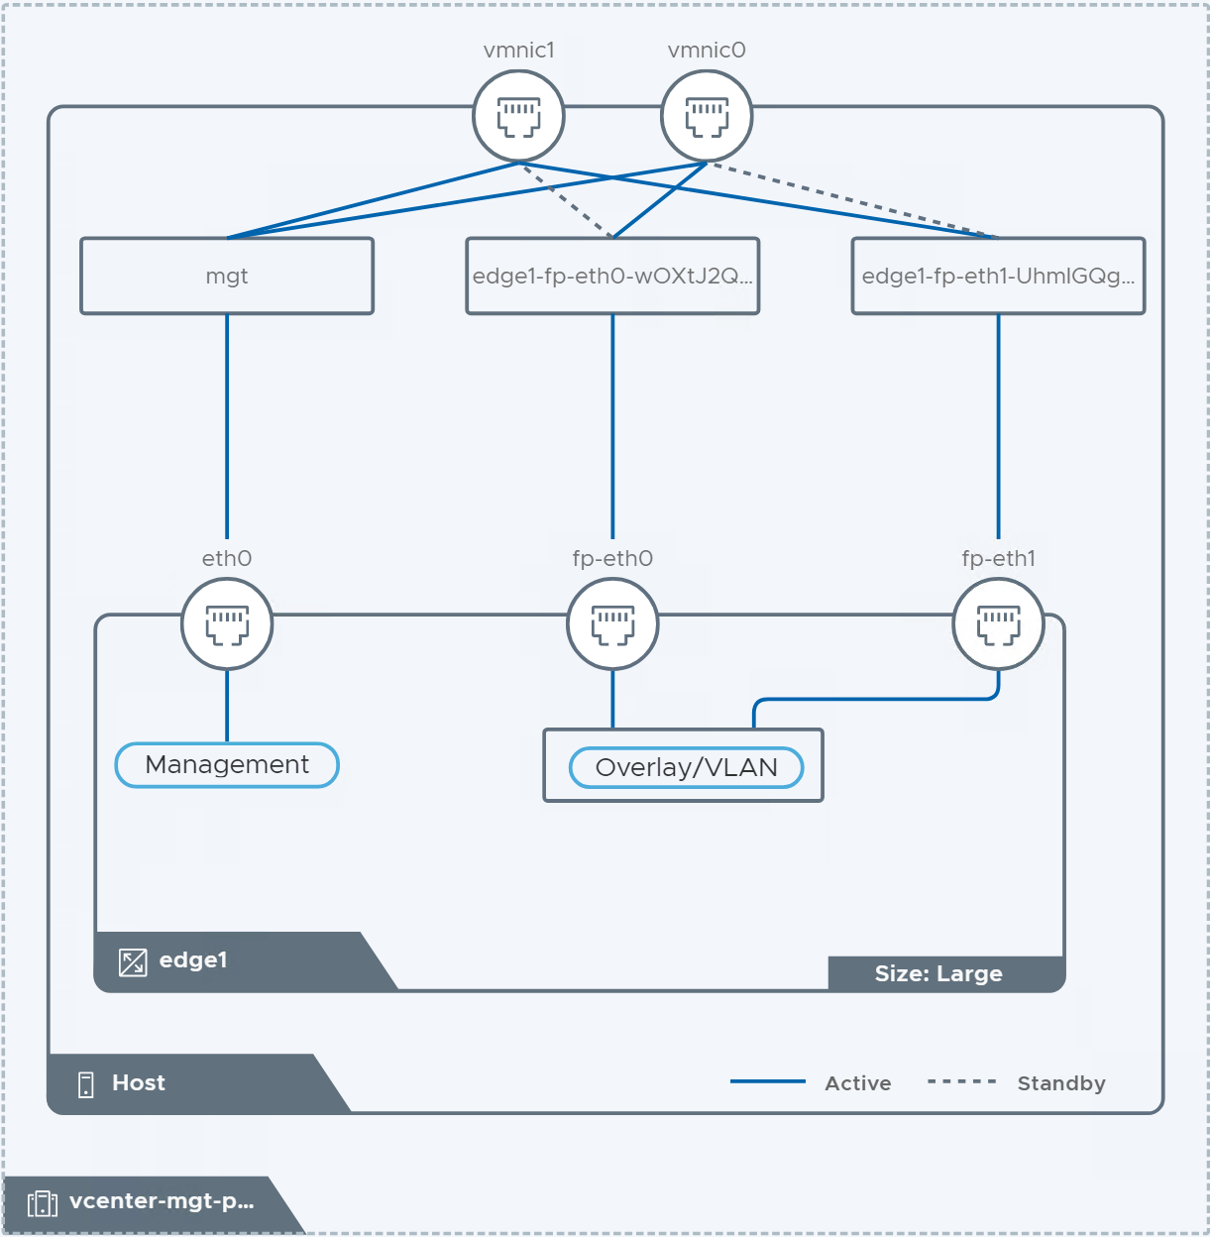
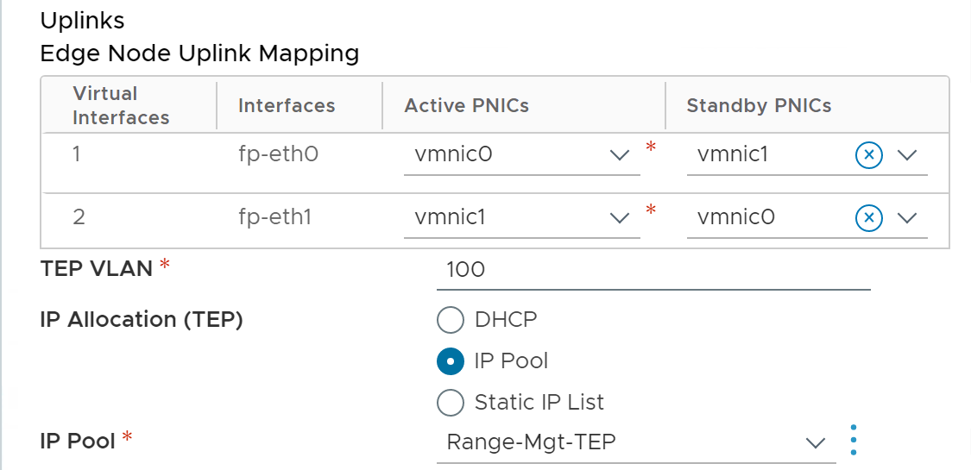
Easily Deploy NSX Edges
Guided edge deployment workflow available in vCenter
Deploy Edges with a simple vCenter UI workflow in VCF 9.0:
The user is guided through entering the required parameters
A graphical representation is generated in real time
Notes:
Key Message:
The new vCenter-integrated workflow simplifies NSX Edge deployment by guiding users through input, automating vSphere and NSX object mapping, and visually displaying configurations, reducing complexity for non-expert users.
Talk Track:
NSX Edges are essential service appliances within the NSX architecture.
Their deployment requires careful alignment between dvPortGroups and VDS uplinks on ESX hosts and NSX Edge fast-path interfaces - an often-complex task for less experienced users.
A new deployment workflow, now integrated into the vCenter UI, simplifies this process by guiding users through the necessary inputs, automatically mapping vSphere and NSX objects, and providing a real-time visual representation of the configuration.
This significantly streamlines the deployment of Edge VMs, a critical component of NSX.
Notes:
Resources:

Slide 28
Independent Connectivity Options for Each Tier
Introducing the Transit Gateway and VPC Gateway
PHYSICAL NETWORK
The enterprise admin creates external connections
They represent connectivity to the physical network
Can be centralized or distributed (resp. Tier0 or VLAN)
Transit Gateway (TGW)
Owned by the project admin
One per project today
Can be centralized or distributed, based on the external connection selected by the project admin for N/S connectivity
Virtual Private Cloud Gateway (VPC GW)
Local to a VPC
The transit gateway interconnects the VPC gateways within a project
Tier0
Gateway
VLAN
External Connection
Project
Transit
Gateway
VPC
VPC
VPC Gateway
subnet
subnet
Notes:
Presenter Note: This slide contains animation
Key Message:
The multi-tier gateway model enables Enterprise, Project, and VPC Admins to make independent connectivity decisions, with Project Admins using transit gateways to connect projects to external networks, and VPC Admins leveraging VPC gateways to connect subnets within each VPC.
Talk Track:
We’ve seen that the VPC model defines three distinct roles, each with clear responsibilities.
Now, let’s look at how these roles work together to establish connectivity, and the key objects involved in making that happen.
The Enterprise Admin manages interactions with the physical network and provides connectivity options to Project Admins by defining "external connections."
These external connections are profiles that describe how access to the physical network is delivered.
<click 1>
An external connection can represent either a connection centralized through a Tier-0 gateway on an edge node or distributed direct access via a VLAN.
<click 2>
The Project Admin, who has no direct access to the physical infrastructure, manages a new type of gateway called the transit gateway.
By attaching the transit gateway to an external connection exposed by the Enterprise Admin, the Project Admin defines how the project connects to the external network.
The choice of external connection also determines whether the transit gateway will function in a distributed or centralized mode.
<click 3>
Finally, within each VPC, a VPC gateway is deployed.
The VPC gateway connects internal subnets and provides external connectivity by routing through the transit gateway.
Notes:
Resources:

Slide 29

External Connectivity with Centralized Services
Centralized Transit Gateway
PHYSICAL NETWORK
When attached to a centralized external connection, the transit gateway has a component running on an NSX edge.
NSX edges required for:
NAT
DHCP
QoS profiles
Gateway firewall (with license)
Supervisor cluster and VCF automation modern experience
Tier0
Gateway
Centralized External Connection
Transit
Gateway
VPC Gateway
NSX Edge
NSX Edge
ESX
ESX
ESX
ESX
VMWARE CLOUD FOUNDATION
Notes:
Presenter Note: This slide contains animation
Key Message:
When attaching to a centralized external connection, the transit gateway is implemented as a Tier0 VRF.
Based on the Tier0, it can offer stateful services.
This is the most traditional connectivity model offered by NSX. It requires NSX edges.
Talk Track:
When attached to a centralized external connection, the transit gateway is associated with a Tier-0 gateway on an Edge node—effectively acting as a VRF of the Tier-0 for those familiar with NSX.
This tight integration means that all north-south traffic through the transit gateway also flows through the Tier-0 gateway and inherits its redundancy model, whether active/active or active/standby.
This has direct implications on the services the transit gateway can deliver: stateful services are not supported when operating in active/active mode.
<click 1>
Similarly, VPC gateways also require a centralized component on an Edge node to run stateful services.
However, VPC gateways can be assigned Edge resources independently of those used by the transit gateway in a centralized external connection setup.
Services such as SNAT/DNAT, DHCP, QoS, Gateway Firewall, Supervisor Cluster integration, and VCF automation with the modern UI all rely on Edge nodes.
Notes:
Resources:

Slide 30
External Connectivity without NSX Edges
Distributed Transit Gateway
PHYSICAL NETWORK
VLAN
The transit gateway can attach to a distributed external connection.
In that case, it has no centralized component:
NSX edges are not required
All ESX hosts must be connected to a VLAN providing an IP block for external addresses used by VMs
Distributed services:
1:1 NAT and
distributed DHCP
Distributed External Connection
Transit
Gateway
Transit
Gateway
Transit
Gateway
Transit
Gateway
ESX
ESX
ESX
ESX
VMWARE CLOUD FOUNDATION
Notes:
Key Message:
VCF 9.0 simplifies VPC deployment by removing the need for NSX Edge appliances, allowing ESX hosts to route external traffic directly via a distributed external connection.
This reduces complexity but limits services to reflexive NAT and distributed DHCP, while requiring a shared Layer 2 VLAN across all hosts.
Talk Track:
VCF 9.0 introduces the capability to deploy VPCs without requiring NSX Edge appliances, significantly simplifying one of the most complex tasks in NSX.
By attaching a transit gateway to a distributed external connection, each ESX host can independently route VM traffic to external destinations.
However, this model comes with trade-offs:
only basic services like reflexive (1:1) NAT and distributed DHCP are available,
and the physical network must provide a shared Layer 2 domain across all ESX hosts. Unlike traditional NSX overlay networking, this approach requires external VLANs to be extended to each host.
Notes:
Resources:

Slide 31




High Performance Switching out of the box
Enhanced Data Path (EDP) Standard as a default
Enhanced Data Path (EDP) standard is enabled by default for new VCF 9.0 deployments
Does not require tuning
50-70% increased performance (for both bandwidth and packets per second)
EDP driver with improved pNIC queue distribution (pooling and allocations)
EDP dedicated mode can also be configured, as well as the original “standard” VDS mode.
vmknic
VM vmxnet3
VM e1000
Optimized Packet Processing
Fast Path
Slow Path IOChain
Optimized Packet Data Structure
EDP Standard vSwitch
EDP Driver
ESX Host with EDP
Vmware Cloud Foundation
Notes:
Presenter Note: This slide contains animation
Key Message:
The enhanced data path VDS is an improvement over the “legacy” VDS in every respect.
It’s been available for several years and VCF 9.0 makes it now the default for new VDS deployments.
VDS that are imported into VCF 9.0 (converging, importing or upgrading for example) are left unchanged.
Talk Track:
Enhanced Data Path (EDP) is a high-performance virtual switch with two modes of operation: standard and dedicated.
By default, new VCF 9.0 deployments run EDP standard mode on the VDS, while upgrading to VCF 9.0 will not change the VDS mode.
Like the legacy VDS, the EDP VDS is interrupt-driven and uses CPU cores on demand.
<click 1>
However, with its DPDK-based operations and packet data structure, it offers higher performance across all workloads without tuning.
<click 2>
EDP delivers a 50-70% increase in performance, improving both bandwidth for large-flow workloads and packets per second for workloads exchanging a high rate of small packets.
<click 3>
EDP drivers optimize pNIC performance.
Even for older pNICs with limited features will see an improvement compared to legacy standard VDS.
<click 4>
The dedicated mode assigns specific CPU cores for packet processing, offering even better performance for specialized workloads.
It requires tuning based on careful consideration of traffic type and average packet size and is typically used in Telco environments.
The legacy standard, non-EDP, VDS mode remains available.
Notes: - In VCF 9 EDP is the default choice when configuring a Virtual Distributed switch.
Resources: For further detail on configuring EDP please refer to :
https://techdocs.broadcom.com/us/en/vmware-cis/nsx/vmware-nsx/4-2/installation-guide/transport-zones-and-transport-nodes/enhanced-datapath-1.html

Slide 32
Fleet Management
VCF OPERATIONS
Unified Operations Experience
Centralized Fleet Lifecycle Management
Non-disruptive Upgrades
Single Sign-on for Administrator Access
Centralized Certificate Management
Centralized Password Management
Configuration Drift Management and Assessment
Unified Tag Management
VCF Download Tool for Disconnected Sites
Notes:
Unified Operations Experience
Centralized Fleet Lifecycle Management
Non-disruptive Upgrades
Single Sign-on for Administrator Access
Centralized Certificate Management
Centralized Password Management
Configuration Drift Management and Assessment
Unified Tag Management
VCF Download Tool for Disconnected Sites

Slide 33











Unified Operations Experience
VCF Operations and VCF Fleet Management
VCF Fleet
VCF Operations
VCF Automation
VCF Fleet Management
VCF Health & Diagnostics
(formerly Aria Skyline)
VCF Operations
Identity & Access
Integrated Log Operations
VMware Cloud Foundation Instance
Certificate Management
Integrated Network Operations
vCenter Server
NSX Manager
Password Management
Integrated Storage Operations
Tag Management
Core Infrastructure
Integrated Troubleshooting & Observability
Configuration Drift
Security Operations
Lifecycle Management
.
Additional VCF Instances
Notes:
Presenter Note: This slide contains animation
Key Message: From VCF 9 private cloud operations and management is performed using the VCF Operations Console.
VCF Operations provides Administrators with a unified and feature rich operations experience for fleet management which spans identity and access management, certificate management, password management, tag management, configuration drift and lifecycle management.
Talk Track:
VMware Cloud Foundation provides IT Teams with everything they need to build, deploy and operate a vSphere-based on-premises private cloud infrastructure. <click 1> VCF Operations provides admins with a unified and feature rich operations experience which expands upon the familiar capacity management and performance monitoring capabilities included in prior versions of Aria Operations. VCF Health and diagnostics has also been adapted from Skyline and is has now also been integrated.
<click 2>
From VCF 9, private cloud operations and management traditionally serviced from SDDC Manager is now also performed using the VCF Operations Console as part of Fleet Management.
Noting that Host and cluster infrastructure-level configuration is now managed from the vSphere client.
VCF Operations Fleet management provides Admins with a unified and feature rich operations experience. This single console spans workload domain deployment, the ability to perform an import of an existing vCenter environment into VCF, identity and access management, certificate management, password management, tag management, configuration management & drift assessment, licensing and lifecycle management of the full VCF stack.
<click 3>
Keeping in mind what we discussed earlier - that a VCF Fleet can consist of multiple VCF deployments which can leverage common VCF Operations and VCF Automations instances.
<click 4> Let’s take a closer look at the components of VCF Fleet Management
Notes:
From VCF 9 VCF Operations is used to manage one or more VCF instances.
A VCF Fleet may consist of multiple VCF deployments which can leverage common VCF Operations and VCF Automations instances.
SDDC Manager 9 is installed or upgraded as a component of any VCF 9 instance. SDDC Manager will be deprecated in a future release.
Resources:

Slide 34
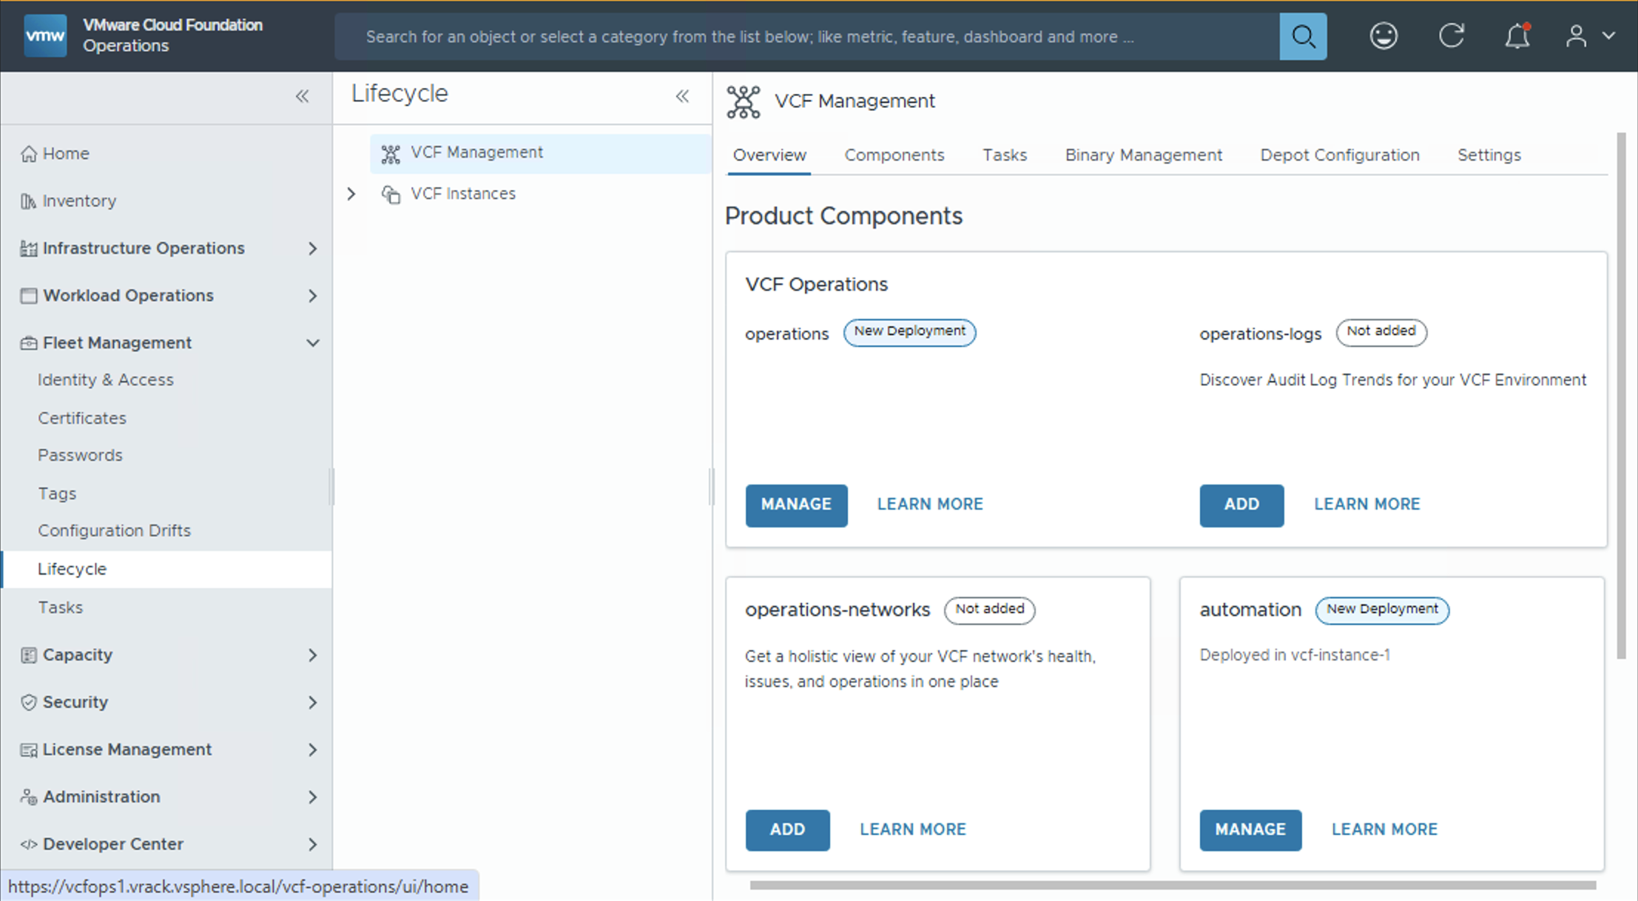
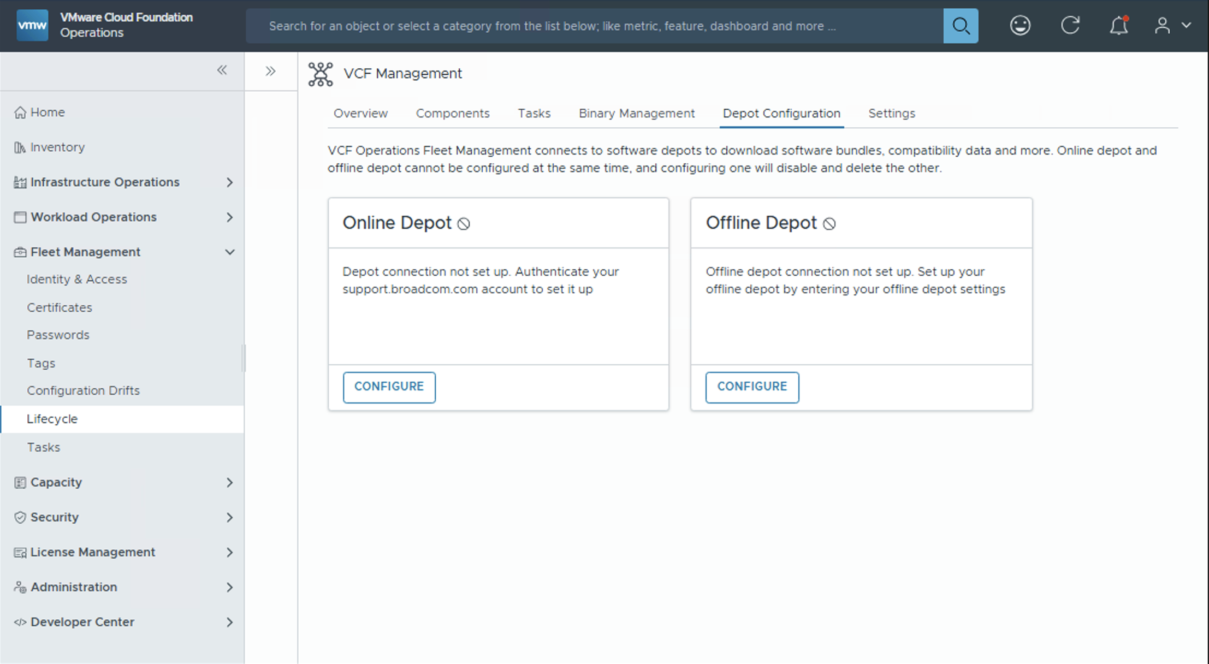
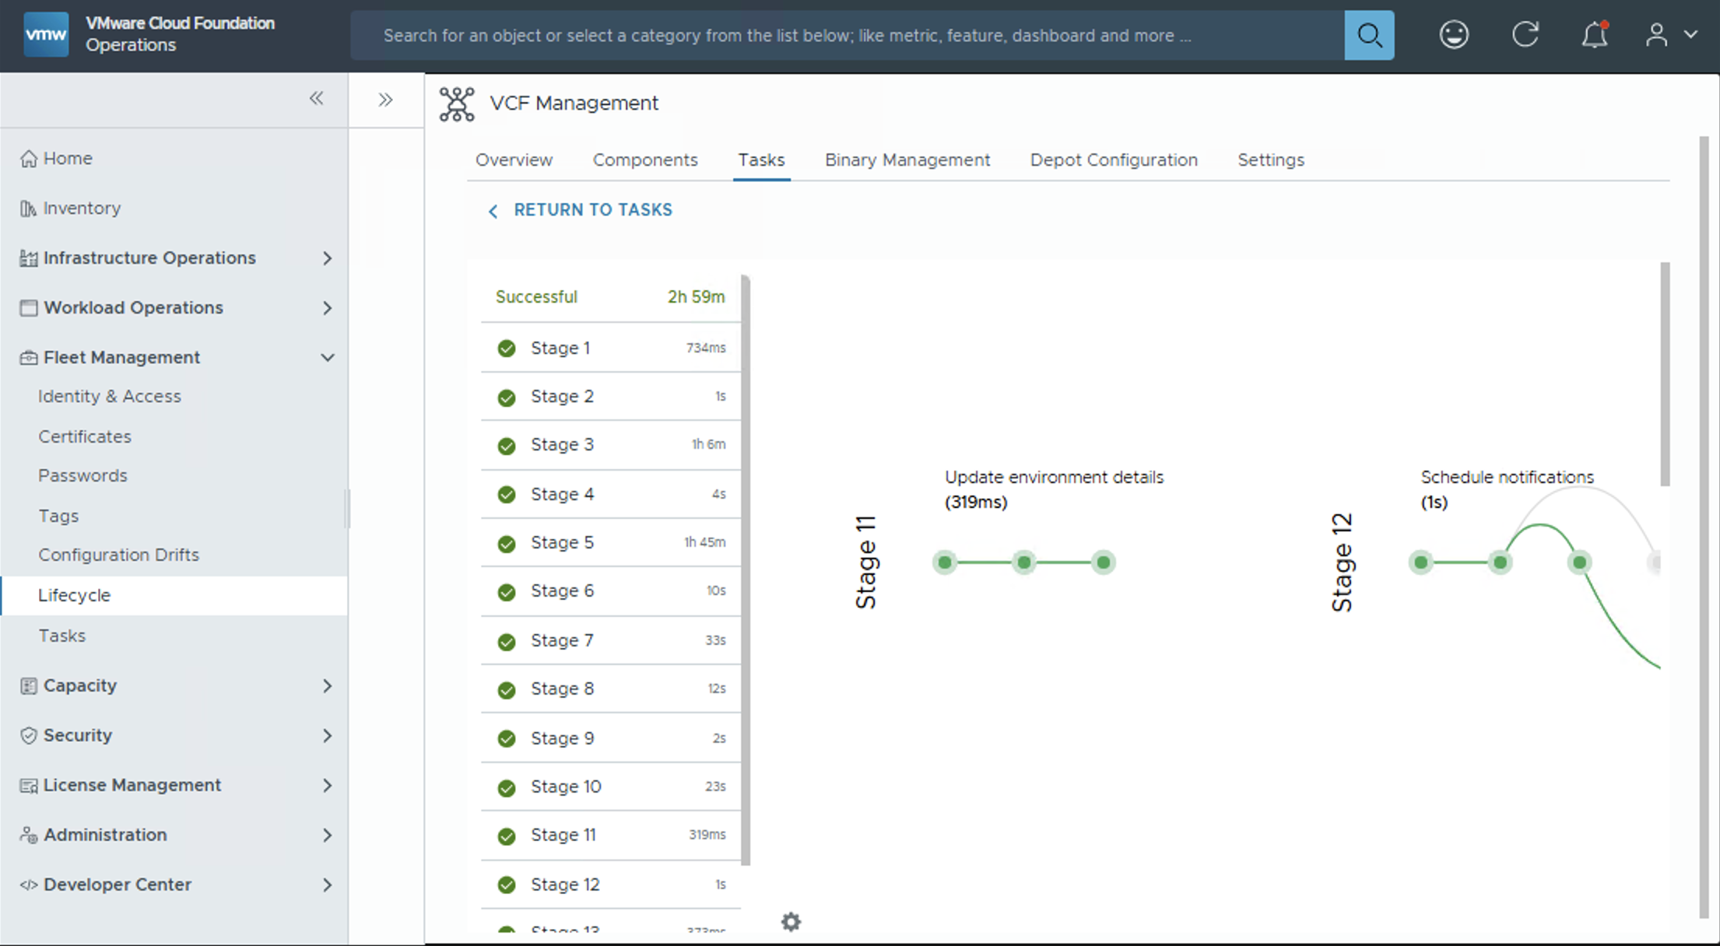
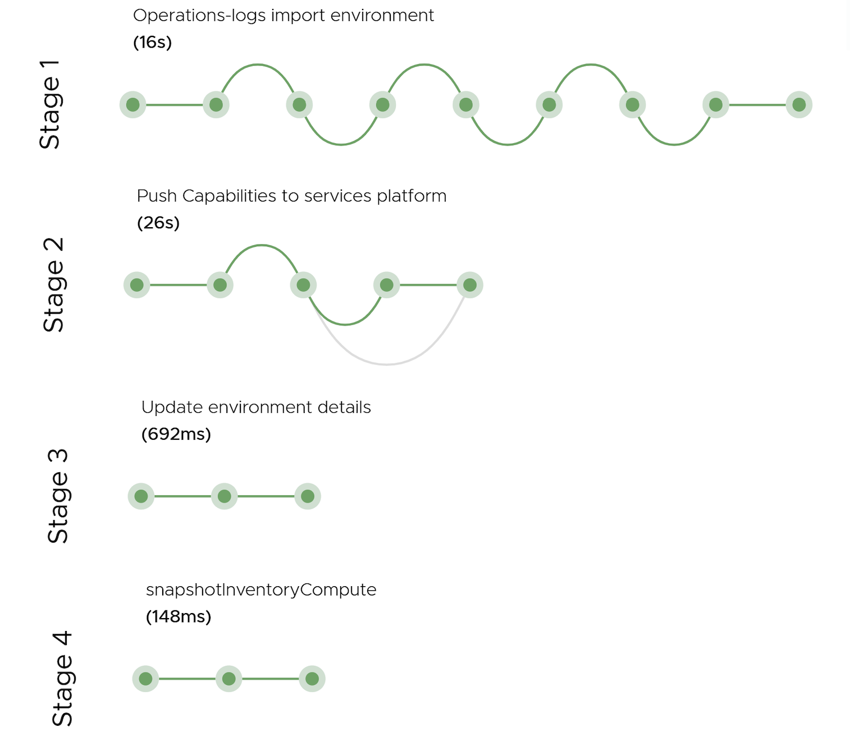
Simplified Lifecyle for VCF Management Components
VCF Operations Fleet Management
Enable and manage components from the Overview pane
Available for VCF Automation, VCF Identity Broker and VCF Operations Fleet Management
“Plan Upgrades” efficiently
Integrations and lifecycle of management components converged into VCF Operations
VCF Depot integration for binaries
Online, Air-Gapped and Dark-Sites
Backup & Restore
Notes:
Presenter Note: This slide contains animation
Key Message:
Suite Lifecycle convergence into VCF Operations console through the VCF Ops Fleet management appliance.
Talk Track: The VCF Operations fleet management serves as a lifecycle manager for management components, facilitating Day-2 operations such as upgrades, certificate and password management, patching, scaling (up and out), snapshot management, marketplace integration and Git integration management.
Fleet Management provides lifecycle capabilities for:
Operations
Operations for Networks
Operations for Logs
Automation
Identity Broker
The Overview page provides a single pane view of all the features which are enabled.
<click 1>
There are two types of depot configurations:
Online Depot:
If fleet management is connected to the internet, then:
Generate Unique ID from Broadcom Support Portal
Save the configuration after accepting certificate
The connection between FL and the depot is established
Binaries of Install, patch and Upgrade will now be available for downloads
Offline Depot:
Download bundles using OBTU and expose it to fleet management via a web server. This is an air-gapped scenario.
Download bundles on OBTU & transfer them over to fleet management to map them locally. This is a dark site scenario.
Once the Depot is configured, fleet management will download the manifest as needed and then display all available and applicable binaries for installs, upgrades or patches.
<click 2>
The Tasks tab displays all tasks executed by fleet management. Each task can have multiple statuses and you can track the progress and manage every deployments from this page.
It also provides Backup and Restore mechanism for Automation, Identity Broker and Fleet Management itself.
Notes:
Resources:

Slide 35
Nondisruptive Upgrades to VCF 9
Move up to the latest version without migration or conversion
VCF 5.x & Aria Suite
VCF 9
Key Benefits
Aria Ops 8
VCF Ops 9
In-place upgrade from 5.x to 9
No need to procure additional hardware to migrate
Take advantage of latest capabilities, including vLCM images
VCF Management
Aria Suite Lifecycle
Fleet Management
5.x
9.0
Technical Value
SDDC Manager
Upgrade to VCF Operations 9 & deploy Fleet Management
SDDC Manager 5.x 🡪 9.0
VCF Ops upgrades remaining infrastructure components
VCF Infrastructure Components
vSphere 8.x. NSX 4.x
vSphere 9 NSX 9
Notes:
Key Message: VCF Upgrade Journey From 5.x to 9
Talk Track:
VCF 5.x can be upgraded to VCF 9 without a "forklift upgrade". No complex migration or conversion steps are required, so you can move directly to VCF 9 without any additional hardware investments. This allows you to unlock the full potential of VCF 9's new features and capabilities right away. The upgrade process is straightforward and involves a series of well-defined steps:
Step 1: Update Aria Suite Lifecycle: First, update Aria Suite Lifecycle to version 8.18 Patch 2. This version is the key to unlocking the VCF 9 upgrade.
It does two important things:
Enables upgrade of Aria Operations 8.18.x to VCF Operations 9: This smoothly transitions your management layer to the latest version, setting the stage for a more streamlined experience.
Deploys the Fleet Management Appliance: This is a new management appliance for the VCF 9 environment. This appliance manages and orchestrates all your VCF management components.
Step 2: SDDC Manager Upgrade: Once VCF Operations is up to speed, upgrade SDDC Manager from version 5 to 9. This upgrade is completed through the familiar SDDC Manager interface, making it a simple and straightforward process.
Step 3: The VCF Infrastructure Component Update: This final stage involves a slight shift in management approach. In VCF 9, we move from SDDC Manager to the new VCF Ops interface for managing your VCF infrastructure components (vCenter, ESX, and NSX). This modern interface offers a more efficient and streamlined management experience.
This is a smooth, well-defined path to bring VCF up to date with the latest advancements. By taking advantage of this upgrade journey, you can unlock the full potential of VCF 9 and elevate your cloud infrastructure to new heights.
Notes:
Keep in mind that migration at this scale has numerous moving parts, this is a simplified overview to introduce the required workflow. Certain other elements will be expanded upon in other technical collateral.
Aria Suite Lifecycle (or vRSLCM) remains as-is until it is no longer needed. For example, it may be required for managing a VIDM deployment, which is not upgradable to VCF 9.
The new VCF 9 licensing model is all new and must be applied after the upgrade is finished. The deployment will be in evaluation mode after the upgrade.
Resources:

Slide 36
Single Sign-On for Administrator Access Across VCF
New modern identity broker simplifies configuration
All new design with two modes:
Embedded
External appliance cluster (supports multiple VCF instances)
Automatic configuration
vCenter, NSX, Ops, Automation
Supports modern and directory-based identity providers
SAML 2, OIDC, or AD/LDAP
Privileges are set for each VCF component according to user/group
No connector needed, since VIDB is inside the firewall
Management Domain
VCF Automation
VCF Operations
Workload Domain
NSX Manager
vCenter Server
NSX Manager
vCenter Server
VIDB
VCF Ops for Networks
VCF HCX
VCF Ops for Logs
OpenID Connect Clients
Notes:
Key Message:
VCF 9: Enhanced Identity and Access Management
Talk Track:
VCF 9 introduces a significant upgrade to identity and access management, bringing enhanced security and streamlined administration to your private cloud environment.
This new VIDB single sign-on service replaces the previous vIDM solution and is built upon modern identity provider technology. VIDB can be deployed in two distinct modes:
- Embedded: Running directly on the management domain vCenter Server, offering out-of-the-box simplicity.
- External Appliance Cluster: Provides scalability and flexibility for larger deployments, where a single VIDB instance can support multiple VCF environments.
VIDB leverages the intuitive VCF Operations interface for easy setup. For the external appliance mode, deployment is managed through the VCF lifecycle management workflow. Once configured, VIDB seamlessly integrates with key VCF components:
- vCenter Server
- NSX Manager
- VCF Operations
- VCF Automation
This enables centralized identity management and automatic single sign-on across your critical cloud infrastructure.
VIDB supports a wide range of industry-standard modern identity providers, offering flexibility and compatibility with your existing security solutions:
- SAML 2.0 and OIDC: For modern cloud-based identity providers like Okta, Ping Identity, Microsoft Entra ID, or any SAML 2.0 provider.
- AD/LDAP: For traditional directory-based authentication.
This empowers administrators with granular control over user privileges, enabling role-based access for different VCF components based on user or group membership.
VIDB’s simplified architecture no longer requires individual component to be configured separately with an identity provider, streamlining administration and reducing potential vulnerabilities. Plus, it is deployed inside the firewall, enabling direct communication with identity providers and eliminating the need for external connectors.
Notes: vIDM is not directly upgradeable to VIDB.
Resources:

Slide 37
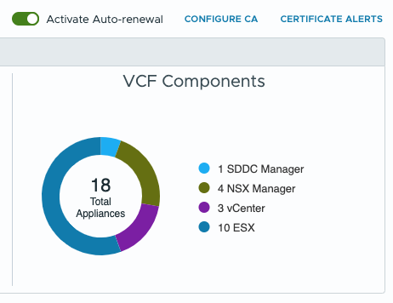
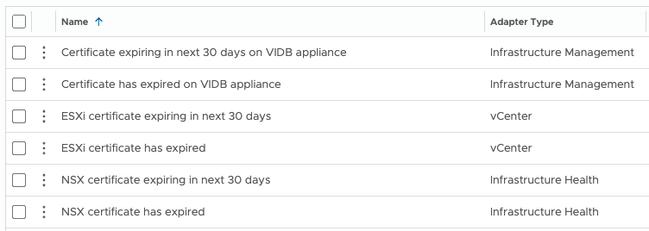
Centralized Certificate Management
Non-disruptive certificate updates for VCF infrastructure and management components
One interface to manage certificates for VCF Infrastructure & Management components
Supports Microsoft, OpenSSL, or external certificate authorities
Automatic renewal
VCF Operations alerts configured out of the box
Manage VMware ESX host certs
New non-disruptive (NDC) architecture delivers fast and reliable certificate updates
Notes:
Key Message:
VMware Cloud Foundation 9 Delivers A Powerful New Approach to Certificate Management
Talk Track:
In VMware Cloud Foundation 9, we're excited to introduce a completely revamped certificate management experience, bringing both the infrastructure and management components under one umbrella. Administrators now have greater flexibility in their certificate management approach, with the ability to leverage existing Microsoft Active Directory Certificate Services CAs, utilize the open-source OpenSSL for certificate generation, or even generate certificate requests for use with external CAs.
<click>
One of the key enhancements in VCF 9 is the automatic certificate renewal functionality when using integrated CAs. This streamlines the process, ensuring certificates are automatically renewed and replaced for compatible components, eliminating the need for manual intervention. The new certificate management infrastructure also integrates with VCF Operations alerts, providing timely notifications about expiring certificates and upcoming renewals, enabling proactive management and minimizing potential disruptions.
The non-disruptive certificate (NDC) architecture makes it fast and safe to update certs on the components without requiring any maintenance windows for the management interfaces.
For organizations with high compliance requirements, VCF 9 also introduces the ability to issue signed certificates to VMware ESX hosts. This ensures that your virtualized environment is compliant with the most stringent security standards, further bolstering your overall security posture.
Overall, VCF 9's certificate management capabilities represent a significant step forward in managing and securing your cloud infrastructure. This new approach delivers enhanced flexibility, increased automation, and improved compliance, ultimately making your cloud environment more secure and efficient.
Notes:
Resources:

Slide 38
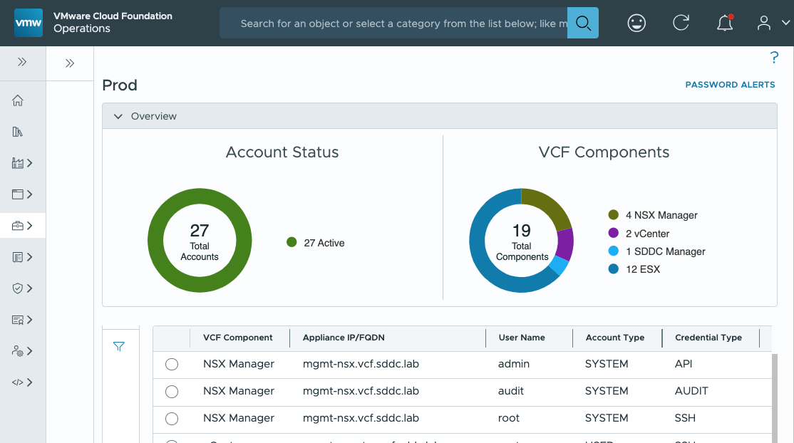
Centralized Password Management
Simplified password management across infrastructure and management components
Manage the key “break glass” admin accounts for VCF components
Passwords can be reset in the case they are forgotten
Remediation is used to sync a password that was changed directly on a component
VCF Operations alerts to warn of upcoming password expiration
No longer a need to rotate service accounts – managed internally
Notes:
Key Message: Streamlined Password Management for Enhanced Security and Efficiency
Talk Track:
VMware Cloud Foundation 9 introduces a centralized and unified password management experience, simplifying and securing your VCF environment.
The new VCF Operations interface brings centralized control: Manage passwords for both infrastructure and management components from a single location.
Eliminate Password Rotations: Service accounts for inter-component communication are automatically provisioned and managed to eliminate the need for manual password management, reducing administrative overhead.
The password management user experienced has been simplified to two operations:
Update Password: Easily reset forgotten passwords through the user interface.
Remediate Password: Synchronize passwords that were changed outside of VCF, ensuring alignment with current configurations.
Integration with VCF Operations also brings another benefit: Administrators will receive timely alerts when passwords are approaching expiration, minimizing security risks and downtime.
Notes:
Resources:

Slide 39
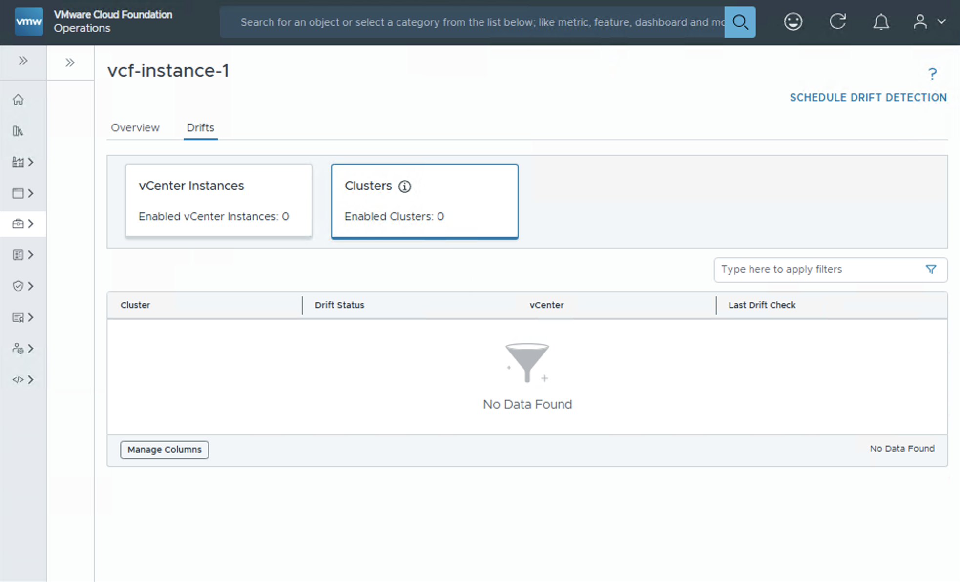
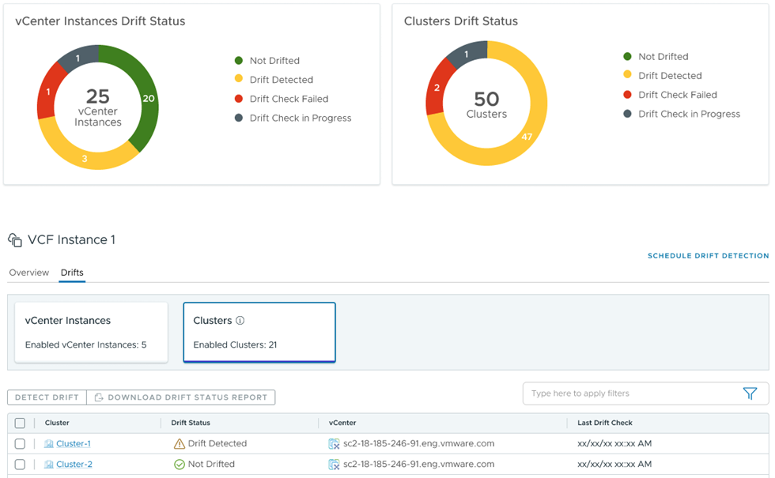
Easily Monitor and Address Configuration Differences
Configuration Drift Management and Assessment
Centrally monitor configuration drift across clusters and vCenters
Deliver smooth operations with consistency and compliance
Reduce risk of security breaches
Ensure environments run smoothly
Automate Drift Detection
Schedule Configuration Drift Reports & automate drift detection
Create and edit Configuration Drift templates
Control template versioning with Git-Integration
Notes:
Key Message:
VCF allows you to monitor configuration drifts in your environment over time in a central location and allows you to compare those changes a standardized template that you define, based on your company standards. It helps to prevent misconfiguration from going unnoticed, reduces the risk of security breaches, and keeps the environment running smoothly.
Talk Track:
When it comes to Configuration Management, Admins face the challenge of enforcing global and regional standards as they struggle to manage configuration drifts across hosts, clusters, VCs, and SDDCs. The process is manual, tedious, prone to error, hard-to-track, and often requires them to use multiple technologies and interfaces.
Unified Configuration Management within VCF alleviates these challenges by preventing misconfiguration from going unnoticed, reducing the risk of security breaches, and keeping their environment running smoothly with the following enhancements and capabilities:
Schedule Drift Detection: Ability to use the VCF Operations console to schedule a Drift Detection job based on the vCenters scoped in a Policy with activated Templates. You can perform an on-demand job, schedule a single job in the future, or a repeatable Drift Detection job. You can see a list of active jobs and historical Drift Detection jobs in the Automation/Orchestration service. The drift status of each vCenter will be stored by the VCF Operations console.
Download the Drift Status Report: Ability to select one or more vCenters with the associated templates and download a PDF report containing the Template drift status of each vCenter within the Configuration Drift Management retention period.
Git Repo Integration: The VCF Operations console retains, displays, and uses one local copy of a Template. In order to perform advanced Template functions like versioning, you can connect the Configuration Template service with a third-party Git-based repository. On successful connection, the VCF Operations console automatically creates a merge request when a Configuration Template is created or modified in the VCF Operations console. The connected Git repository becomes the primary owner of the Templates when the connection is established. Hence, although Templates can be edited and created in the VCF Operations console, you must pull any merged requests from the Git repository.
vSphere Configuration Profile-Enabled Cluster Status: For clusters activated with vSphere Configuration Profiles (VCP), the Configuration Drifts service lists and displays the VCP Drift status of all activated clusters in an aggregated view based on global VCF instances, specific VCF instances, or specific Workload domains.
Edit Configuration Templates: Ability to edit Configuration templates. The Edit template capability allows you to remove and add vCenter Schema Configuration items to an existing Template. Additionally, you can edit values of existing or new vCenter Schema Configuration items. The VCF Operations console validates the edited values before changes are saved.
Notes:
Resources:

Slide 40
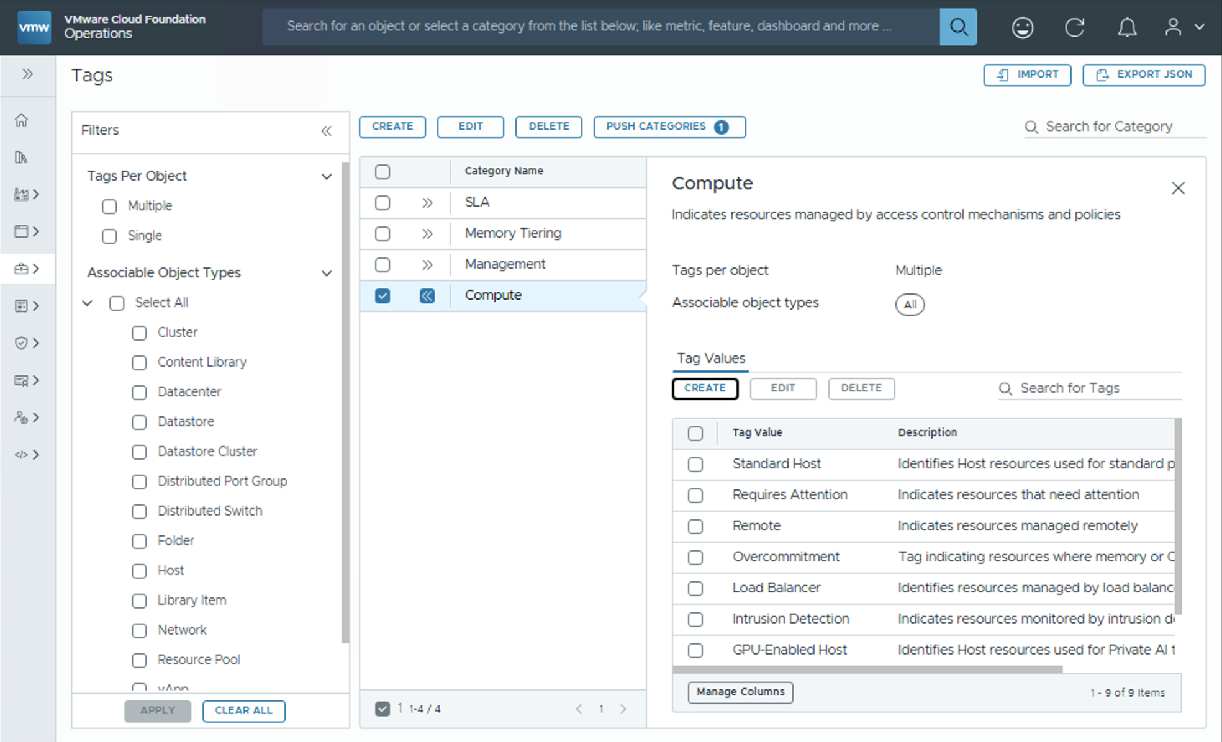
Manage, Identify and Organize Resources
Unified Tag Management
Create, edit, delete categories and tags from a single pane of glass
Import brownfield categories and tags from vCenters and evaluate conflicts
Push categories and tags to vCenters
Pushed tags are persisted across vCenters after vMotion
Centralized consistent behavior across services to create and manage tags
Identify and eliminate duplicate tags across vCenters
Notes:
Key Message:
Customers, the ability to manage tags end to end for all objects, without having to switch consoles.
Talk Track:
Tags can help you manage, identify, organize, search for, and filter resources. Prior to VCF 9, there were multiple different tagging/grouping solutions across vSphere, NSX, vROps, vRA which created some challenges, including Tag Duplication, Tag Loss (if VMs were moved across vCenters), and Tag Inconsistency
Now that these solutions are now unified as VMware Cloud Foundation (VCF), VCF 9 address these challenges by providing customers a Unified E2E workflow to create, manage, assign tags, resolve conflicts without the need for them to manage tags in multiple locations.
With VCF 9, customers can:
Create, edit, delete categories and tags from a single pane of glass
Import brownfield categories and tags from vCenters and evaluate conflicts
Push categories and tags to vCenters
Pushed tags are persisted across vCenters after vMotion
And, as a result of these new capabilities, customers will be able to
Ensure consistent behavior across services to create and manage tags
Easily identify and eliminate duplicate tags across vCenter server
Notes:
Resources:

Slide 41
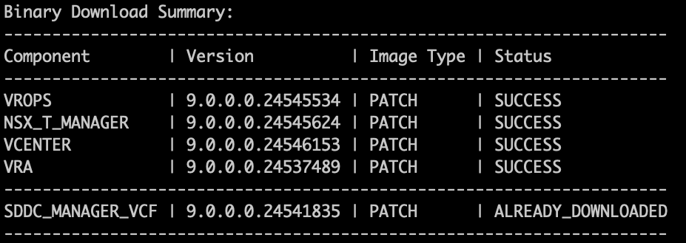
VCF Download Tool for Disconnected Sites
Command-line utility supports new, enhanced offline depot and binary transfer scenarios
New binary download tool
Supports VCF 9+
Integrates infrastructure bundles and UMDS host patches
Essential for disconnected sites
Initial VCF installation
Ongoing lifecycle management
VCF 5.x and below continue to use the original OBTU tool
Notes:
Key Message: New VMware Cloud Foundation Download Tool (VDT) supports disconnected sites
Talk Track:
There are many customers that are not willing or able to allow VCF to directly connect to the Broadcom software depot in order to download software binaries for install, upgrade, and patching.
In these scenarios, admins of disconnected sites can create their own private offline depot with the new VDT. This tool is the successor to the Offline Bundle Transfer Utility (OBTU), and the two tools will coexist, with VDT being for VCF 9+ and OBTU for VCF 5.x and below. Offline depots help provide control and consistency as well as scale to environments with many instances of VCF deployed.
In addition to generating a mirror of the online depot, VDT can also be used to import bundles directly into SDDC Manager, without the need to create an additional internal web server to host the offline depot.
Notes:
Resources:

Slide 42
Private Cloud Operations
VCF OPERATIONS
Integrated Infrastructure Operations - Network
Integrated Infrastructure Operations – Storage
Integrated Infrastructure Operations - Logs
Health and Diagnostics
Fin-Ops – Chargeback
Workload Migration Planning

Slide 43
Private Cloud Operations
VCF Operations
VCF Fleet
VCF Operations
VCF Automation
VCF Fleet Management
VCF Health & Diagnostics
(formerly Aria Skyline)
VCF Operations
Identity & Access
Integrated Log Operations
VMware Cloud Foundation Instance
Certificate Management
Integrated Network Operations
vCenter Server
NSX Manager
Password Management
Integrated Storage Operations
Tag Management
Core Infrastructure
Integrated Troubleshooting & Observability
Configuration Drift
Security Operations
Lifecycle Management
.
Additional VCF Instances
Notes:
Presenter Note: This slide contains animation
Key Message: From VCF 9 private cloud operations and management is performed using the VCF Operations Console.
VCF Operations provides Administrators with a unified and feature rich operations experience for fleet management which spans identity and access management, certificate management, password management, tag management, configuration drift and lifecycle management.
Talk Track:
Lets now take a closer look at closer look VCF Operations, formerly known as VMware Aria Operations.
Notes:
Resources:

Slide 44
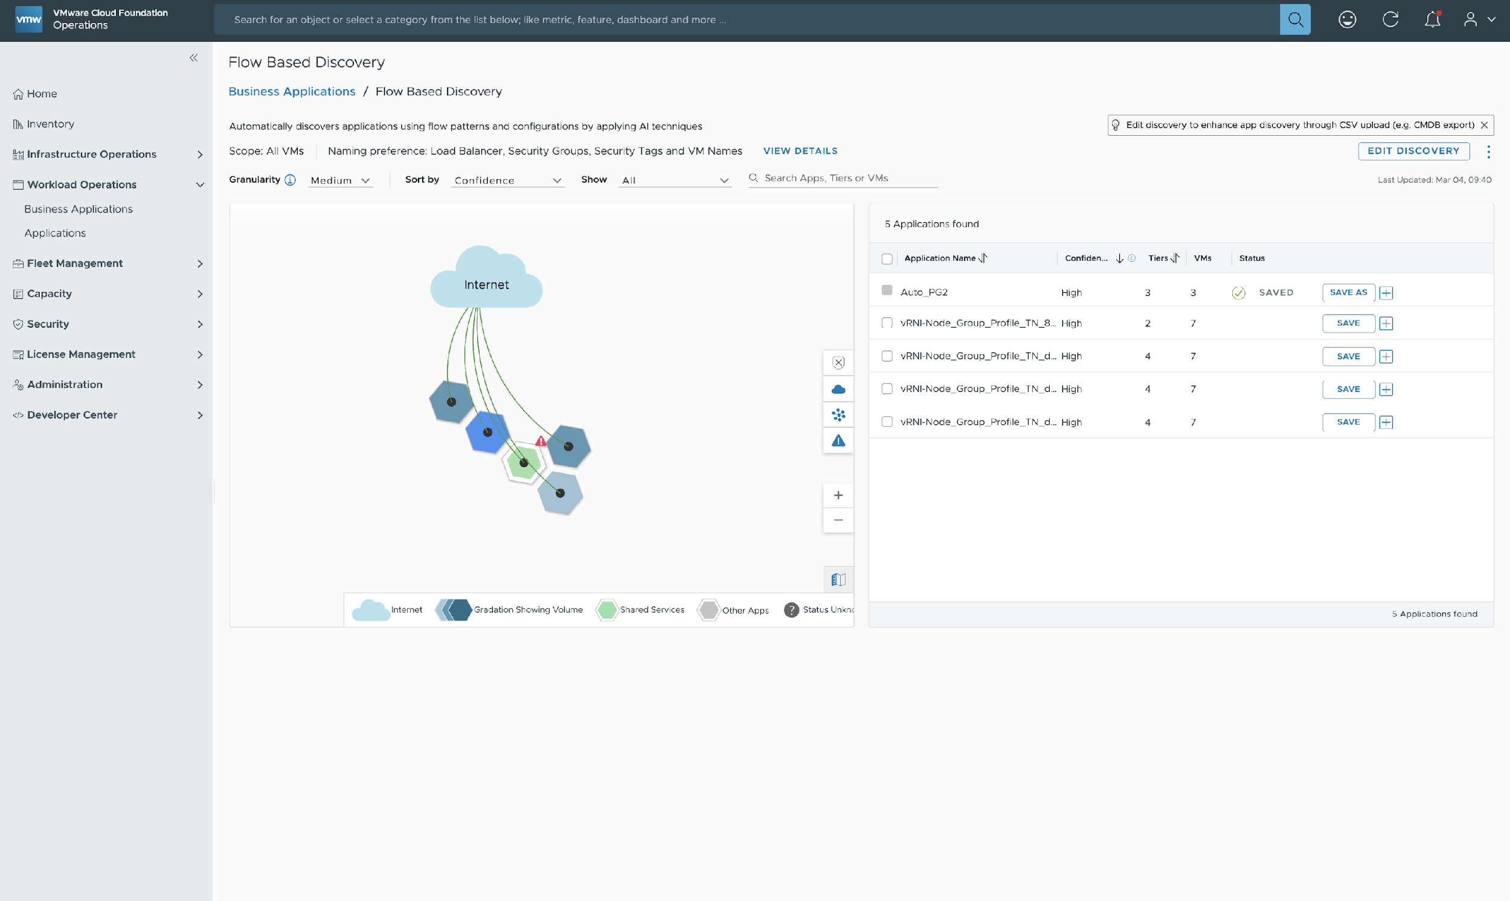
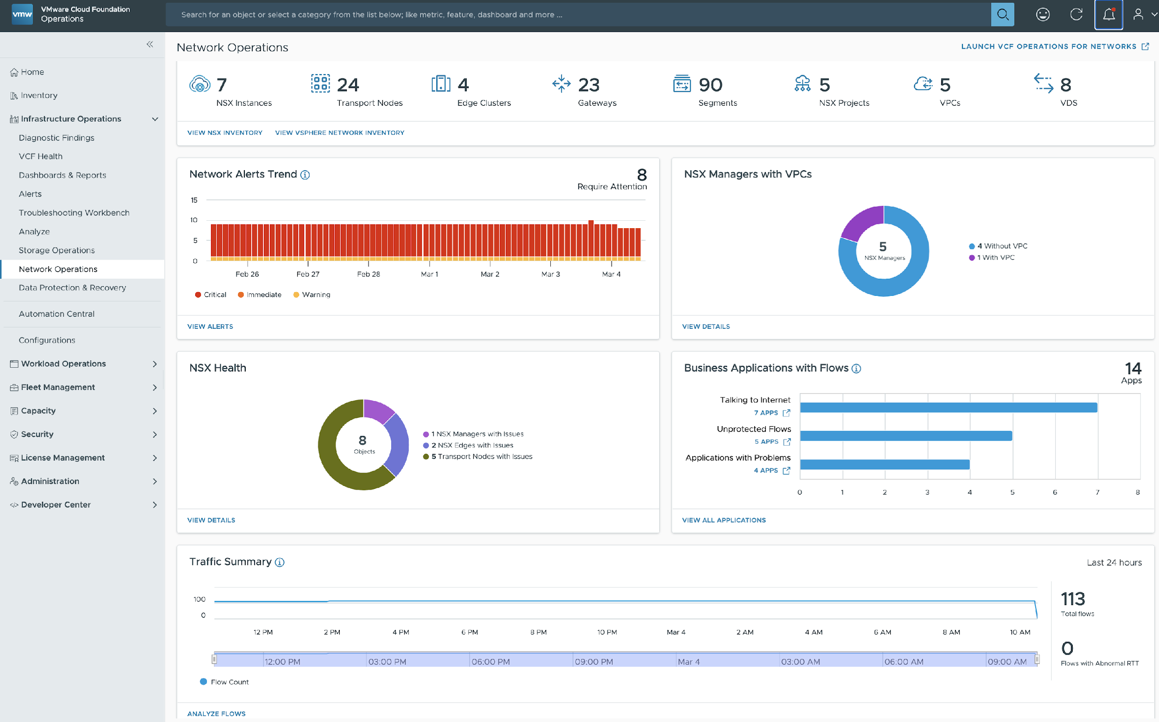
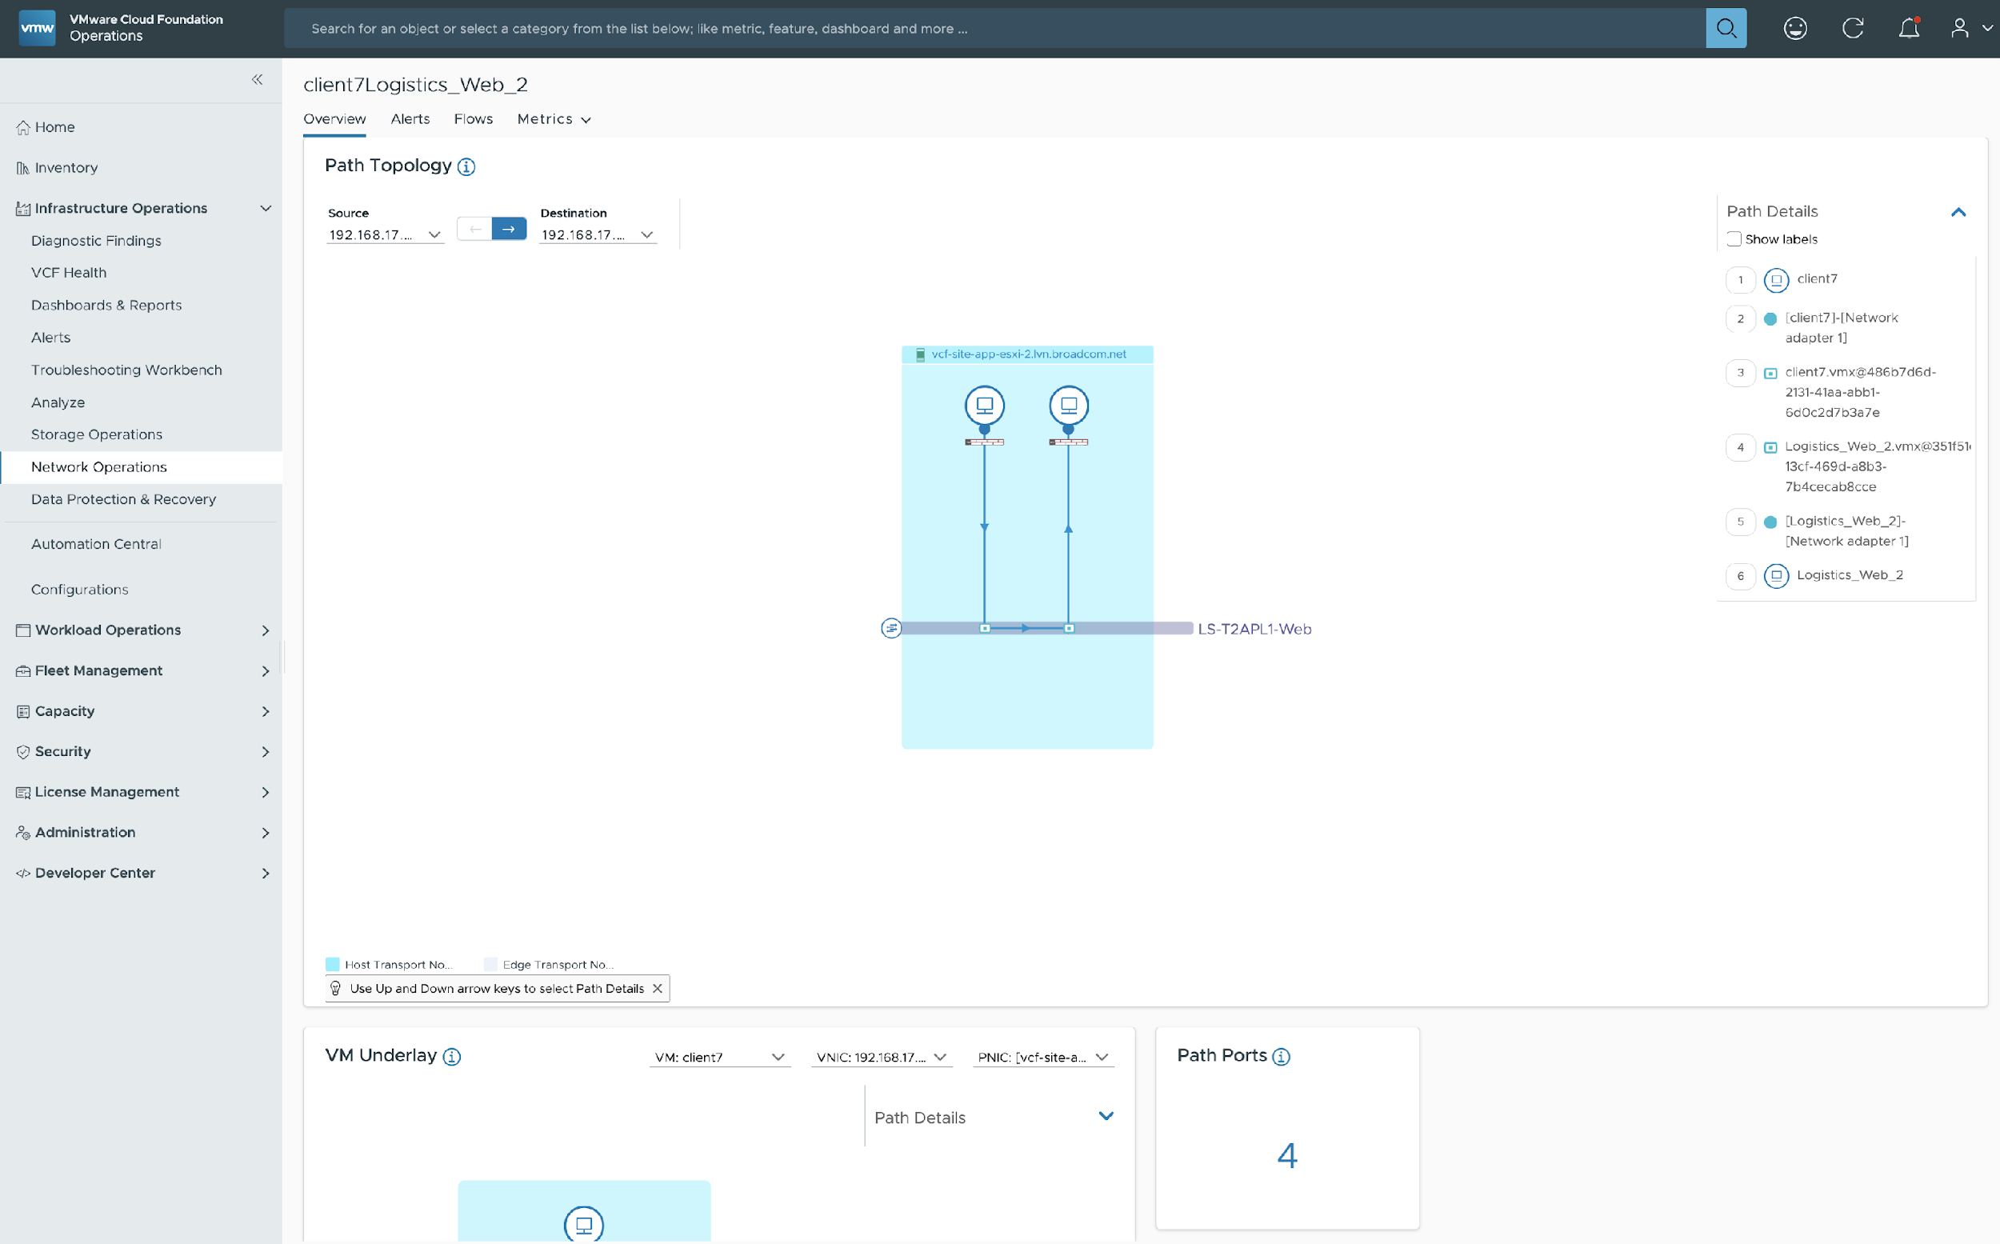
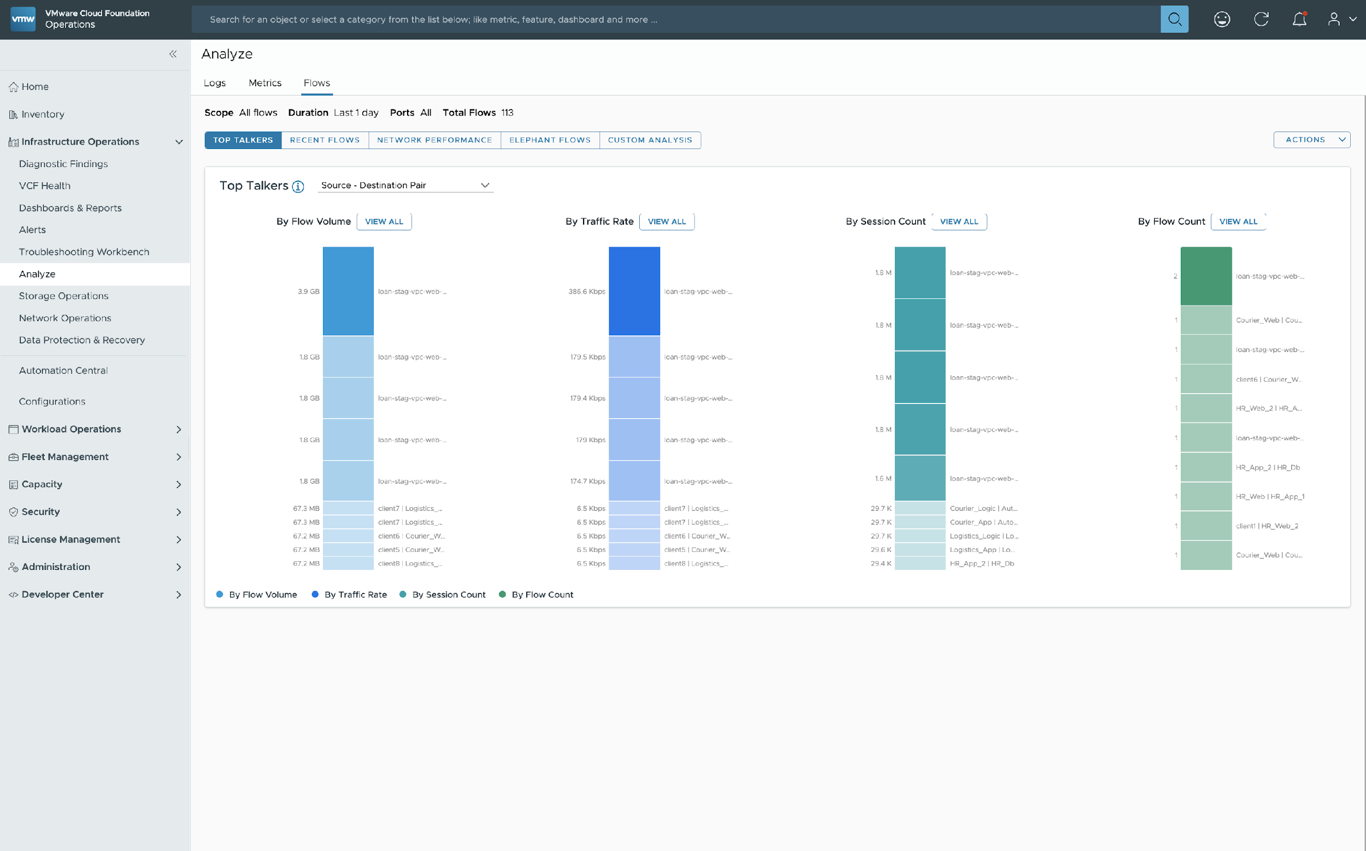
Improve Performance and Reduce Downtime for VCF
Integrated Infrastructure Operations: Network
Network Operations Home Page
Comprehensive view of entire VCF network
Faster troubleshooting of traffic issues with flow insights
Unified experience for Data source addition
Analyze Flows in addition to metrics and Logs
End-to-end Path Analysis and flow metrics
Discover Business Applications insights using Flow based discovery
Notes:
Presenter Note: This slide contains animation
Key Message:
VCF Operations 9.0 provides a single pane of glass view of Network Operations to improve Performance and reduce network downtimes Talk Track: VMware Cloud Foundation (VCF) is a full-stack, secure private cloud solution that combines storage, networking, computing with cloud management capabilities. So, Now with VCF Operations 9.0, no matter what you are looking at we have ONE PLACE for you to look at it"
You can monitor the entire VCF environment with a single configuration made in the operations console.
With the new Network Operations Home page under Infrastructure Operations, VCF Operations offers enhanced network visibility, network troubleshooting, optimization planning and workload migrations.
One of the pre-requisites is to get the VCF Operations for Network appliance deployed. So, with its integration, you see an
*Overview of VCF network inventory
*NSX inventory (transport nodes, edge clusters, GW, VPCs),
*Network Alerts (Alerts on network elements including VCF network and third party.)
*NSX Managers with VPC enabled
*Monitoring health of the NSX components and diagnostics capabilities
<click>
The Top Talkers widget can help find busiest entities within the VCF deployment like VMs and containers within an application or k8s cluster, busiest traffic by flow volume, traffic rate, session count, flows count in your environment. Similarly, you get insight into abnormal flows, outliers in addition to metrics and logs.
<click>
The VM to VM Path analysis helps to plot the network hops or path a source entity takes to reach the destination entity over the network. We can find out how a VM or container is communicating to say a DB instance on a virtual machine and hops involved like Logical port -> Logical switch -> Physical switch device to reach out to internet.
VCF Operations extends visibility to your NSX networks and physical networks tying that picture ALL TOGETHER so that you have single Pane of Glass view able to monitor network operations within your VCF infrastructure.
<click>
So, with VCF Operations 9.0, you can now discover applications using the Flow based application discovery (FBAD) which internally uses Machine Learning algorithm to identify network traffic patterns and group the VMs together.
Using the network traffic flows from either the vSphere Distributed Switch(vDS) or NSX, this method uses Machine Learning techniques to discover application boundaries and tiers and helps in defining application portfolio. It also helps in keeping applications up to date with new changes by automatically detecting new flow patterns and topology changes.
Notes: x
Resources: x

Slide 45

Improve Performance and Reduce Downtime for VCF
Integrated Infrastructure Operations: Storage
Storage Operations
vSAN Performance
vSAN Perf Diagnostics
All new dashboards to monitor and manage storage powering VMware Cloud Foundation
Storage Operations Overview
vSAN Performance
vSAN Performance Diagnostics
Holistic views provide at-a-glance conditions across multiple clusters
Key metrics and health information retrieved from vSAN APIs
VCF Ops
VCF Ops
VCF Ops
VMware Cloud Foundation
vSphere
vSAN ESA
vSphere
vSAN ESA
vSphere
vSAN ESA
vSphere
vSphere
vSAN HCI
vSAN HCI
vSAN HCI
vSAN ESA
vSAN SC
vSAN storage cluster
Notes:
Presenter Note: This slide contains animation
Key Message:
VCF Operations 9.0 provides a single pane of glass view for Storage Operations to improve Performance and reduce storage related downtimes
Talk track:
Global visibility and insight for storage has been improved in VMware Cloud Foundation 9.0. Three new dashboards are available to help take some of the mystery out of storage administration within your VCF deployment. A storage operations overview will be your go-to dashboard for at-a-glance viewing of your storage environment. A vSAN performance page will allow you to easily summarize the performance condition of a selected cluster. While the vSAN performance diagnostics page will let you easily test new clusters entering production, or existing cluster already in production to understand their health and performance readiness.
----------------------------------
Overview:
All new dashboards to monitor storage powering VMware Cloud Foundation
Storage Operations Overview
vSAN Performance
vSAN Performance Diagnostics
Holistic views provide at-a-glance conditions across multiple clusters
Key metrics and health information retrieved from vSAN APIs
----------------------------------
Details:
vSAN has always provided a wealth of heath and performance information in vCenter Server. The level of detail paired with our unique ability to understand the storage path from end-to-end means that vCenter Server can provide storage related insight not possible with other solutions. Unfortunately, vCenter Server is unable to show meaningful metrics beyond the cluster level. It is an even greater challenge with more than one vCenter Server in the mix. For VCF installations that are comprised of many vSAN and vSphere clusters, this can make it challenging for administrators to get a simple at-a-glance view of their entire data center.
VCF Operations in VCF 9 addresses this challenge. VCF Ops now provides three new dashboards that aim to provide the most important storage-related information easily, and quickly across your VCF instance. This helps provide a centralized location for improving the simplicity of day-to-day storage administration.
There are three new storage dashboards included in VCF Operations
Storage Operations Overview. This provides the following information across multiple clusters, included in the following widgets:
Storage alert trends. This shows the number of critical alerts and warnings in a stacked bar chart over a given time period
Usage and distribution. This will show the total amount of used capacity against the total amount of free capacity in a bar chart. It will denote the usage for vSAN clusters in a different bar chart than the other datastores used in the VCF instance.
vSAN Cluster Health Score. This will show a bar chart of the number of clusters and their cluster health score, but will only list clusters running 8.0 or later. It will be divided into three bars. One representing the number of clusters with a cluster health score of 0-60 (attention required), another representing 60-80 (attention recommended), and another representing 80-100 (healthy). This helps one easily determine the status of cluster health in a single location.
vSAN Cluster Types. This will provide a pie/donut graph breaking down the cluster count of OSA clusters, ESA clusters, compute clusters, and storage clusters.
vSAN cluster performance. This will show a scatter-plot of cluster performance that measures latency on the Y axis, and IOPS on the x-axis.
vSAN cluster information. This will show vSAN clusters in a tabular format that summarizes the information clearly, including items such as:
Cluster name
Associated vCenter Server
OSA vs ESA
Cluster health score
Number of hosts
Number of VMs
Capacity usage
Space efficiency ratio
IOPS
Latency
Data-at-Rest encryption enabled/disabled
Data-in-Transit encryption enabled/disabled.
vSAN Performance. This provides a performance focused summary of vSAN clusters. It provides a single location to identify issues with vSAN performance. They are broken down into the following widgets
Selection of a vSAN cluster. This provides a list of vSAN clusters in tabular form, and includes basic metrics including controlling vCenter Server, latency, IOPS, etc. Whatever cluster is selected in this widget will dictate the performance information in the other widgets in the dashboard.
Top-N VMs. This will show a list of VMs with a horizontal stacked bar chart that will display the total latency
Top-N Hosts. This will show a list of hosts with a horizontal stacked bar chart that will display the total latency
Top-N Disk groups (OSA). This will show a list of disk groups with a horizontal stacked bar chart that will display the total latency.
Metrics Picker. This gives a hierarchical listing of metrics that can be dragged and dropped into the adjacent time based line graphs to the right. This provides an easy way for administrators to customize a view without extensive expertise in creating dashboards.
vSAN Performance Diagnostics. This capability will allow a diagnostics report to be run on a selected vSAN cluster. A user can set the time range for the test to be performed, with a “benchmarking goal” where a user could select IOPS, throughput, etc. It will also allow the administrator to set the “diagnostics goal” of the test, including:
Troubleshooting (production cluster)
Benchmarking and Optimization (new cluster).
The vast majority of vSAN-related metrics gathered and rendered by VCF operations are fetched via vSAN APIs. This helps provide consistent measurements, and reduces computational activities for VCF Ops.
Limitations
TBD
Positioning
VCF Operations (previously Aria Operations, and vRealize Operations) has had a dubious history of providing insight that is actually helpful to our customers. The new storage dashboards have been built from the ground up to offer insight that isn’t easily attained in vCenter Server, but using the very same metrics.
Feature value in one sentence. The new storage dashboards in VCF Operations simplifies storage administration for your VCF environment.
Common Use Cases.
TBD
----------------------------------
Additional Information:
TBD

Slide 46
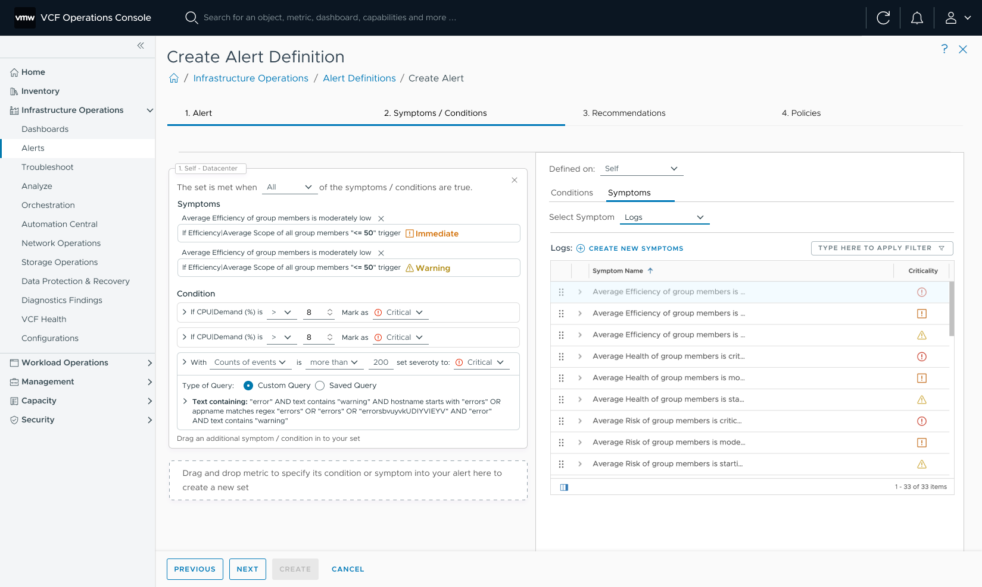
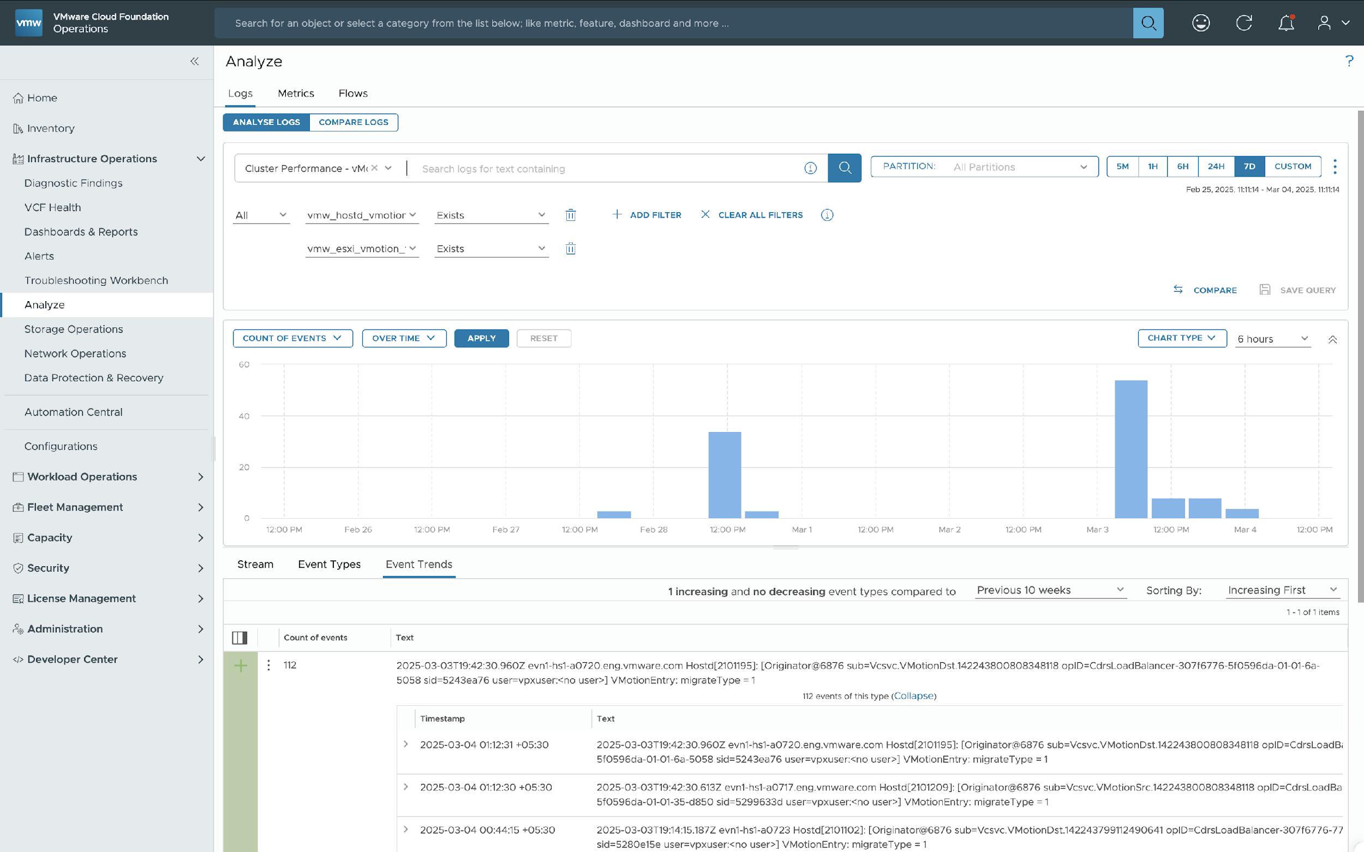
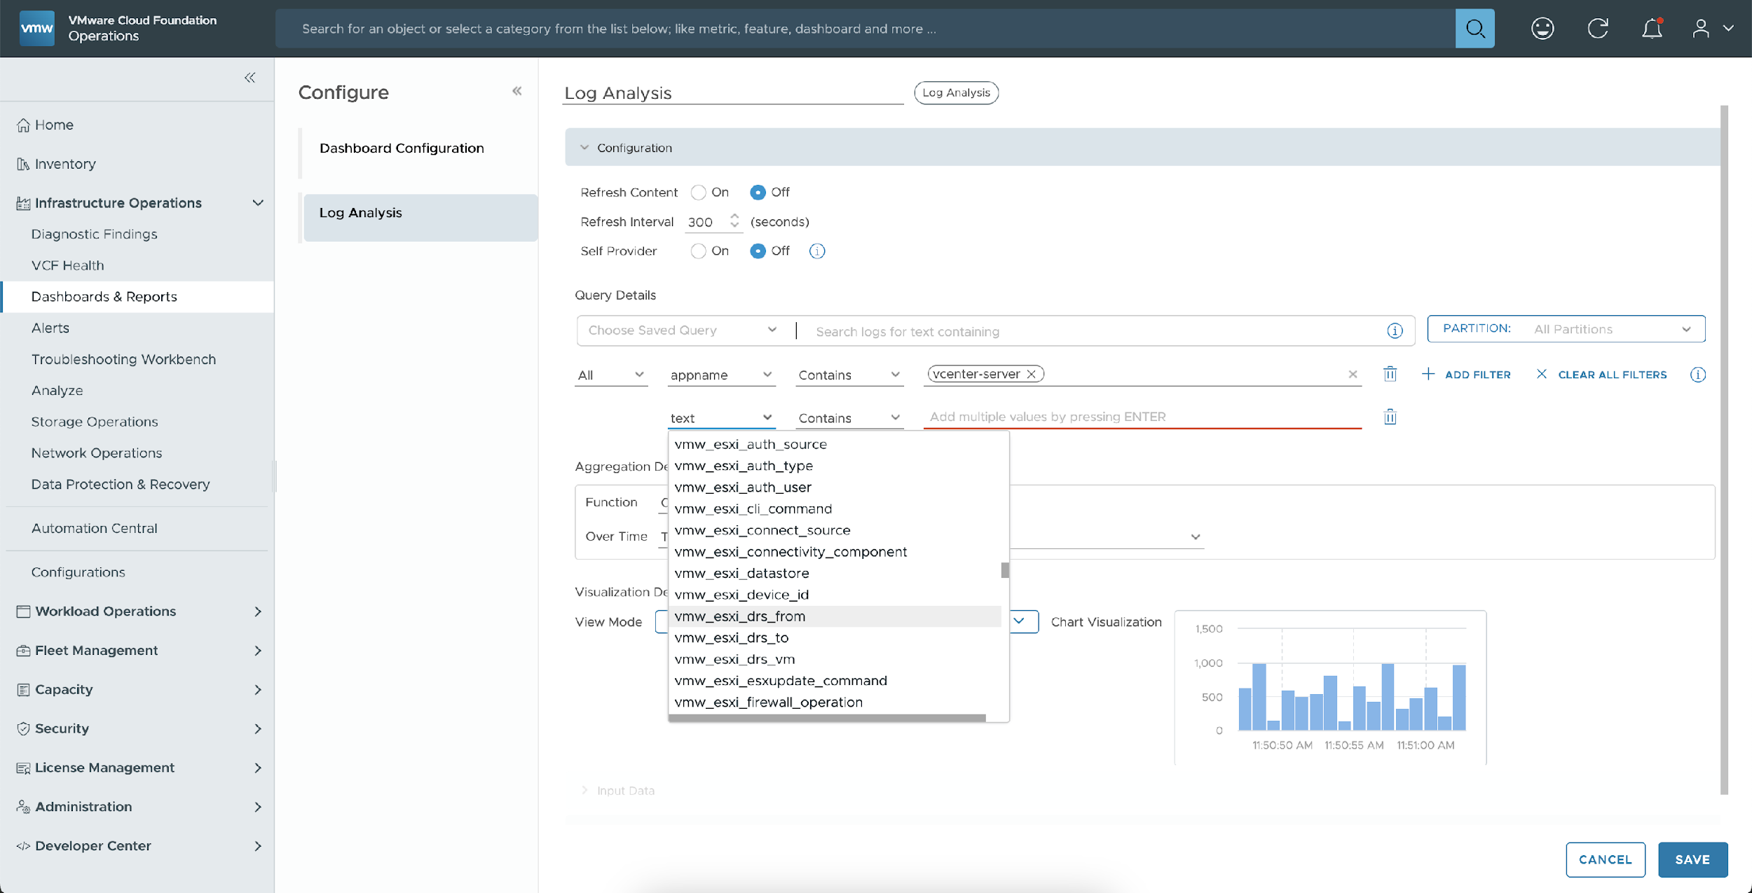
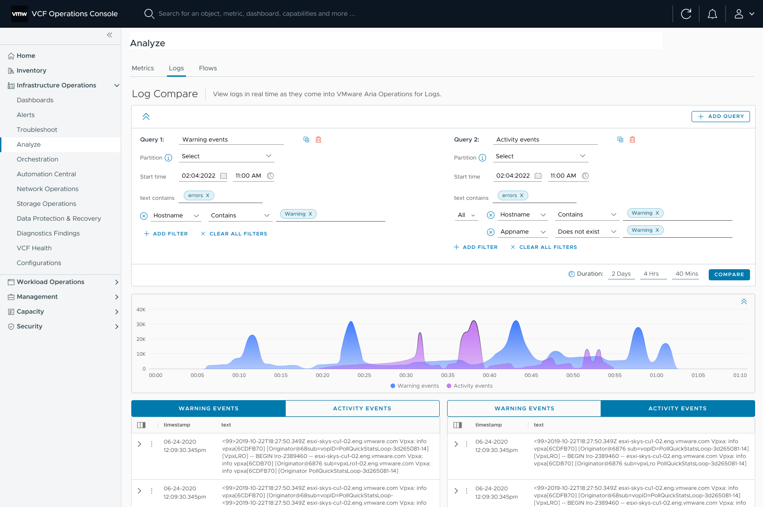
Improve Performance and Reduce Downtime for VCF
Integrated Infrastructure Operations: Logs
Analyze logs with powerful queries and visualization charts
Accelerated troubleshooting with easy access to logs
Enhanced Log Analysis widget for creating Log-based dashboards
Trigger alerts based on log events and visualize through charts
Compare Logs to identify anomalies; issue resolution with a side-by-side comparison
Collect Logs and Events from all VCF Components
Notes:
Presenter Note: This slide contains animation
Key Message:
VCF Operations 9.0 converges Operations for Logs User experience with ability to access and manage log data directly into VCF Operations console
Talk Track: With VCF Operations 9.0, you get a New integrated experience into VCF Operations with ability to filter and search log events, ability to analyze logs based on powerful queries and virtualization charts. In the Analyze Logs page, you can search and filter log events, and create queries to extract events based on timestamp, text, source, and fields in log events.
<click 1>
The Log Analysis widget within the Dashboard gets new powerful filters with support for different event types and trends with filters. This helps to uncover insights into logs through the queries and charts.
<click 2>
You now get ability to define new alerts based on logs. Alerts can be triggered based on log events over time. Unifying Alerts and metrics with Log Queries provides comprehensive Monitoring and proactively identifies potential problems for early issue detection
<click 3>
You can now compare logs from different time periods or log sources to identify anomalies. It helps to determine problems due to new deployments or change windows by reviewing difference in log streams. Using Log Compare capability, users can quickly detect and resolve issues through side-by-side comparison. Currently you can compare up to four log streams simultaneously. Transfer logs up to 90 days from 8.x Logs to VCF Operations
Notes: x
Resources: x

Slide 47
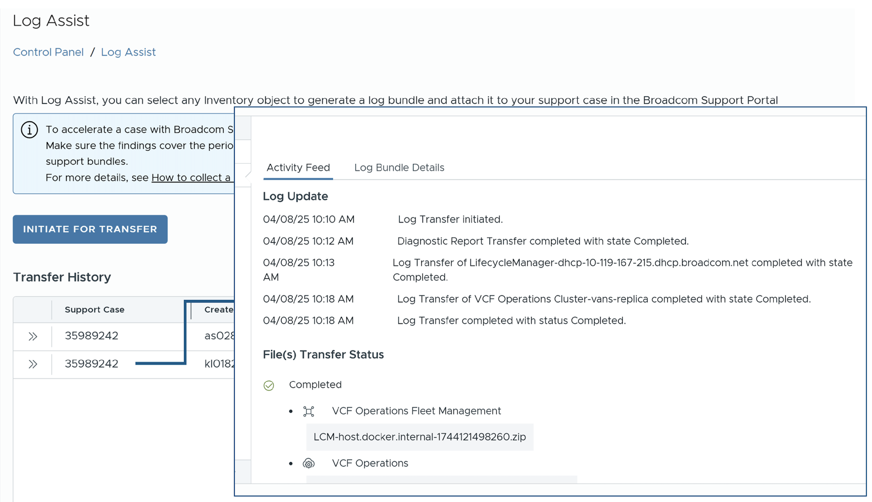
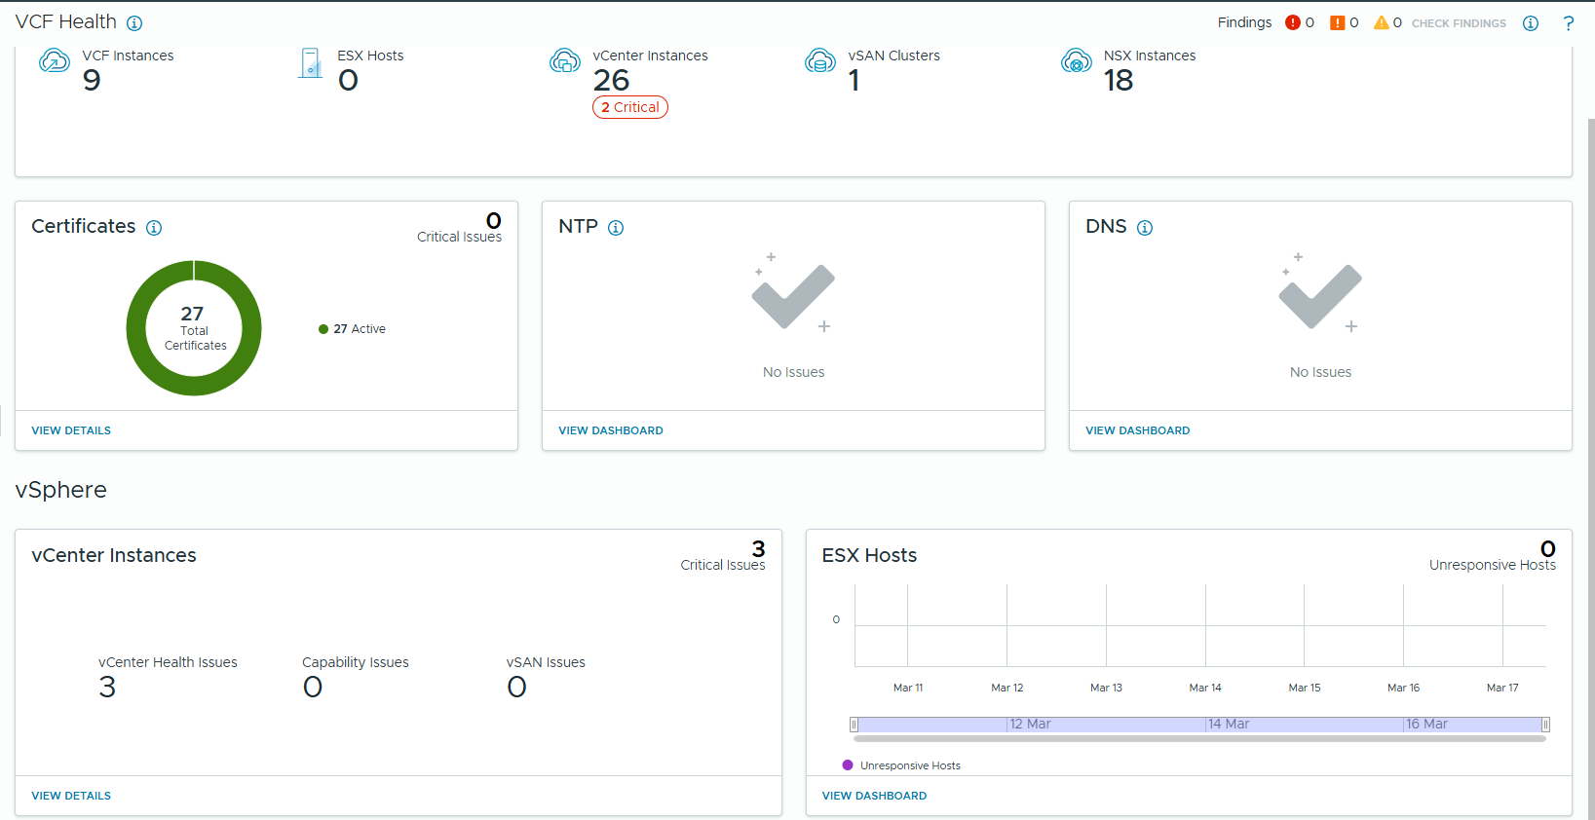
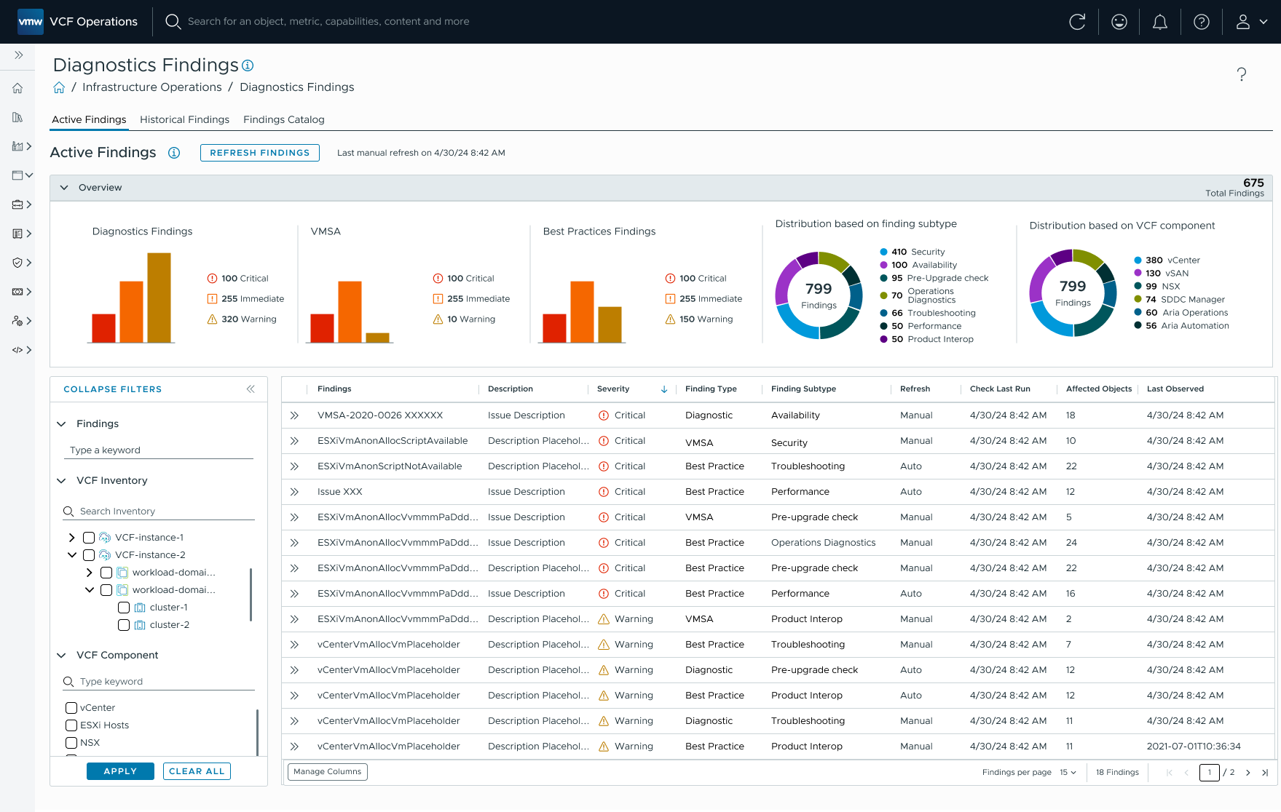
Discover and Address Known Issues Impacting VCF Software
Health and Diagnostic: Findings, Health Status & Log Assist
Faster issue detection & resolution
Less reliance and fewer support requests
Reduced turnaround time for issue resolution
Single console to diagnose known issues impacting VCF Health
Understand impacted components with curated remediation steps
View security risks (CVE &VMSA)
Generate and attach log bundles for VCF components
Notes:
Presenter Note: This slide contains animation
Key Message:
VCF’s Diagnostic Findings and VCF Health provides a single-pane-of-glass to correlate issues across your infrastructure.
Talk Track: Maintaining a stable, secure, and a resilient environment is a constant challenge for Sys Admins. They need tools that will accelerate the discovery and prevention of costly issues before they occur and speed SLAs, with the help of Broadcom Support, when they can resolve issues on their own.
VCF Health and Diagnostics addresses these challenges with the following capabilities:
Diagnose known issues impacting VCF software in a centralized location (single-pane-of-glass)
View security risks based on CVE and VMSA
<click 1>
Understand impacted components with curated remediation steps, including ESX unresponsive hosts, vSAN & NSX health, significant NTP issues, DNS lookup failures, vCenter connectivity, utilization and availability, and VMs that need snapshot consolidation.
And if an issue, such as a Security Advisory Finding that requires immediate attention is identified, you can see impacted objects and get recommendations on how to remediate the issue yourself.
<click 2>
Package and send relevant Log data, with VCF’s Log Assist capability, to Tech Support to speed issue discovery and drive faster SLAs.
Extended Talk Track:
Reduce service requests and drive faster SLAs with VCF Health & Diagnostics. VCF Operations provides granular visibility into the overall health of your environment. This feature leverages log data to detect both potential and active configuration and security issues, and it also suggests relevant Knowledge Base articles or steps to remediate the issues on your own.
Notes:
Resources:

Slide 48
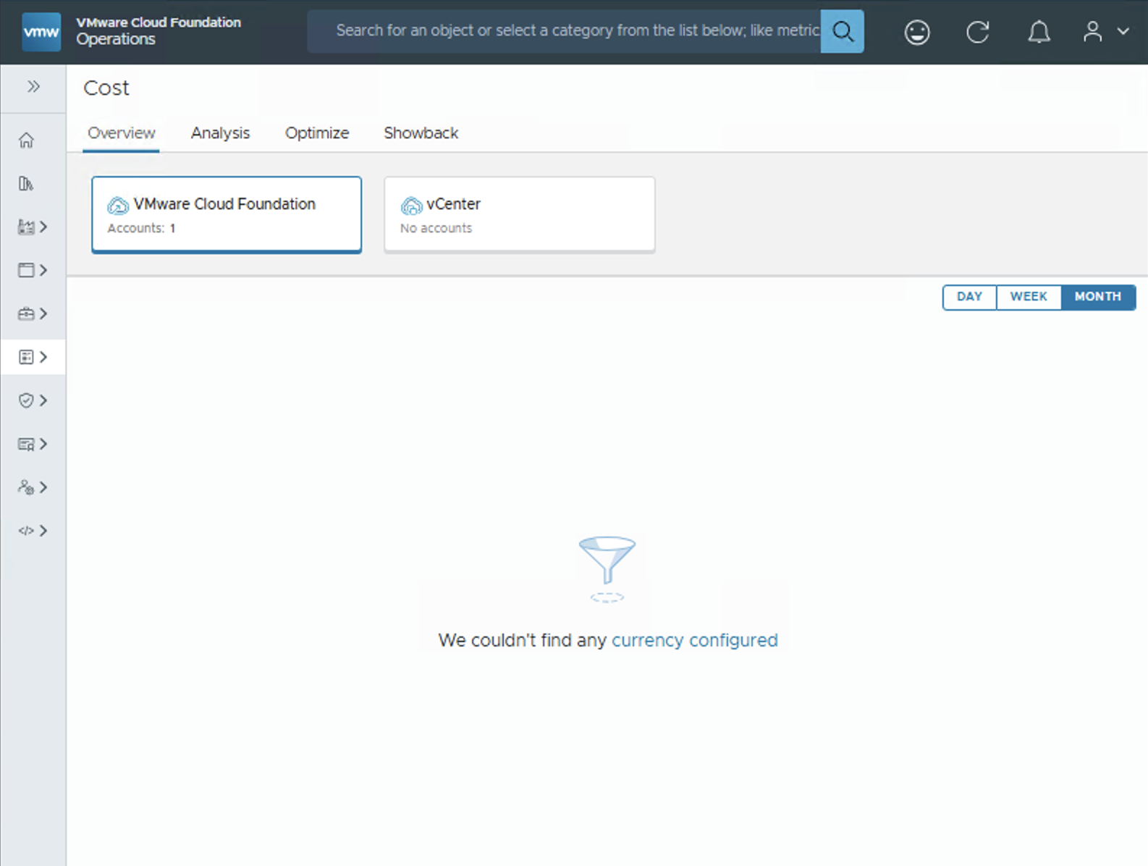
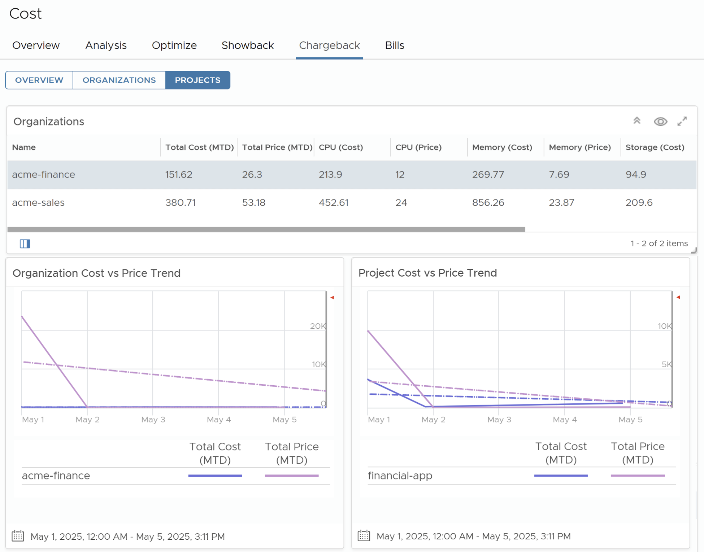
Easily Generate Accurate Bills for Tenants
FinOps Chargeback
Define pricing on various metering options
Easy on-demand and scheduled generation of bills per tenant
Bills are visible to tenant administrator on the Automation Console
Charge tenants for the infrastructure based on compute, storage, fixed costs, tags, metadata
View and download bills with details on breakdown of charges
Rate cards based on org and region combination
Notes:
Key Message:
VCF Chargeback gives customers the ability to generate and communicate accurate billing information to their tenants, based on their actual use of resources, as well as provide tenants with the confidence that the billing is accurate.
Talk Track: Customers face the challenge of balancing operational efficiency and fairness when setting of chargebacks for the purpose of billing their tenants. And without the proper tools in place, chargebacks can be a very manual, time-consuming process that, not only, impacts operational efficiency, but can also lead to disputes with tenants who don’t have the transparency they need to understand their bill.
Chargeback in VCF alleviates these challenges with the following capabilities:
Define Rate Cards: Providers can define Rate Cards that calculate metering rates for Compute, storage, and networking, as well as other agreed-upon costs for any org-region combination.
Generate Bills (On Demand or Scheduled) : Providers can generate bills for tenants as there are needed, as well as automate their creation with its scheduling capability.
Share generated bills with tenants: Once a bill is generated, tenants can see a detailed breakdown of their costs via the Automation Console in VCF.
Notes:
Resources:

Slide 49
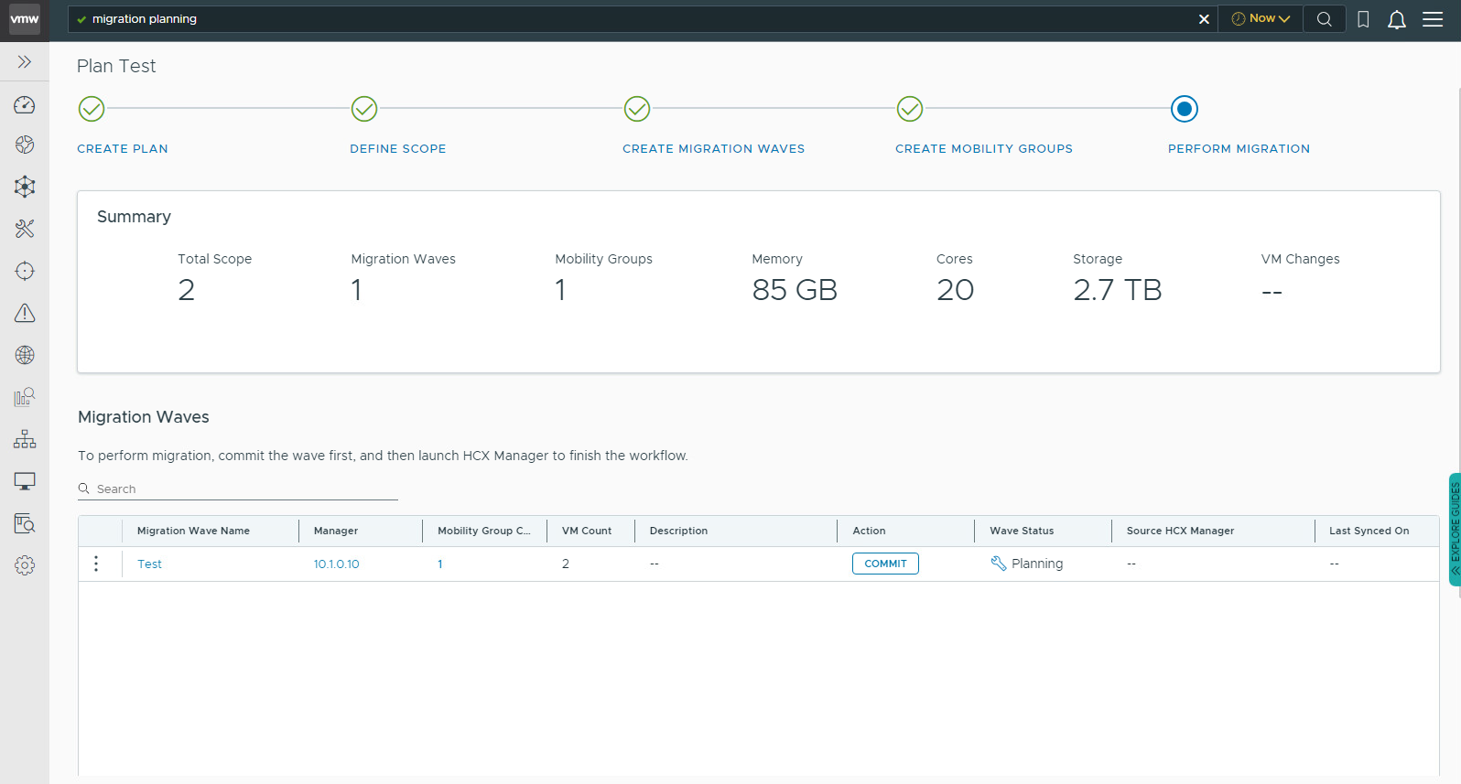
End-to-end Process: Plan, Schedule and Migrate Workloads at Scale
Workload Migration Planning
Define Scope using Applications or Members of Applications
Discover Application & Network Dependencies
Create Migration Waves
Overview of Resource Consumption
Create Mobility Groups and Commit to HCX for Migration
Supported Scenarios On-prem; vSphere only: Migration from Non-VCF vSphere/vCenter to VCF (M&A, DC consolidation)
Notes:
Key Message:
VMware’s migration planning process provides an end-to-end solution for planning, scheduling, and migrating workloads at scale. The structured approach ensures minimal disruption, improved efficiency, and a seamless transition to VCF (VMware Cloud Foundation).
Talk Track:
1. Introduction to Workload Migration Planning
• Many organizations face challenges when migrating workloads at scale, including application dependencies, resource allocation, and ensuring a smooth transition.
• This solution simplifies and streamlines migration with a guided step-by-step workflow.
2. Migration Planning Process
• Define Scope: We begin by identifying applications or members of applications that need migration.
• Discover Dependencies: A crucial step is mapping out application and network dependencies to ensure seamless migration without breaking critical services.
• Create Migration Waves: Workloads are grouped into logical migration waves, ensuring controlled execution.
• Resource Overview: The platform provides a comprehensive view of memory, cores, and storage required for the migration.
• Create Mobility Groups & Commit to HCX: We ensure optimized workload movement by creating mobility groups while leveraging HCX for migration execution.
3. Supported Migration Scenarios
• This approach supports on-premises vSphere migrations, including transitions from non-VCF vSphere/vCenter environments to VCF - ideal for M&A activities or data center consolidation.
Benefits:
• Reduces Complexity – Provides a structured workflow to manage large-scale migrations efficiently.
• Minimizes Downtime – Through dependency discovery and well-planned migration waves, we ensure minimal impact to business operations.
• Resource Optimization – The platform offers insights into required resources, avoiding bottlenecks and over-provisioning.
• Scalability & Efficiency – Designed to handle migrations at scale, supporting enterprises undergoing infrastructure modernization.
• Seamless Integration with HCX – Ensures workload mobility without extensive manual intervention.
Notes: x
Resources: x

